Slide 1
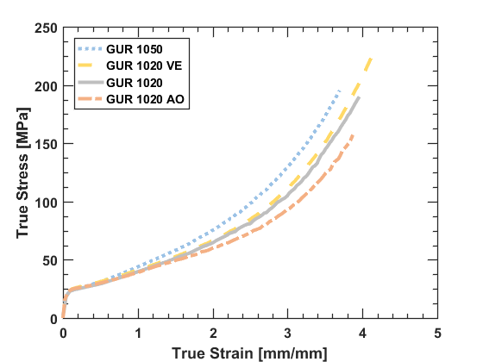
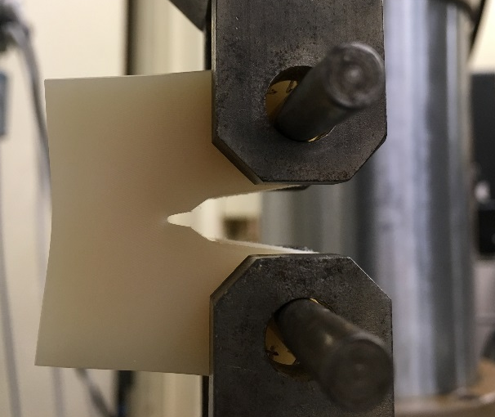
Characterization Methods for Structure-Property Relationships in Clinical Formulations of UHMWPE
Louis Gregory Malito¹
¹University of California, Berkeley
Adam Kozak², Stephen Spiegelberg² PhD, Anuj Bellare³ PhD, Lisa Pruitt¹ PhD
²Cambridge Polymer Group, ³Brigham and Women’s Hospital, Harvard Medical School
8th International UHMWPE Meeting
Torino, Italy
Oct. 19th 2017

Slide 2
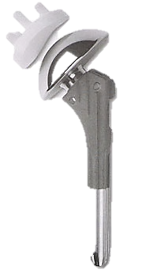
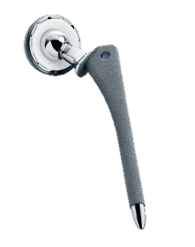
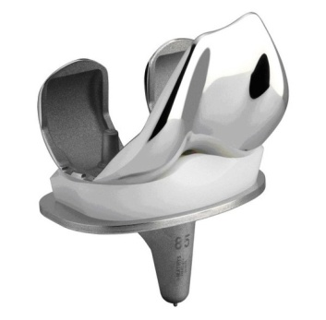
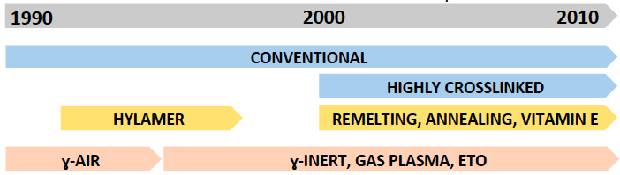
Motivation
900,000 TJR annually in U.S. and majority utilize UHMWPE.
Simple mechanical characterization methods are needed for material comparisons and retrieval analysis.
Numerous clinical formulations of UHMWPE in varying crosslink dose, thermal treatment and antioxidant chemistry.
Total Shoulder Replacement
Total Hip Replacement
Total Knee Replacement
healthbase.com,, springerimages.com

Slide 3
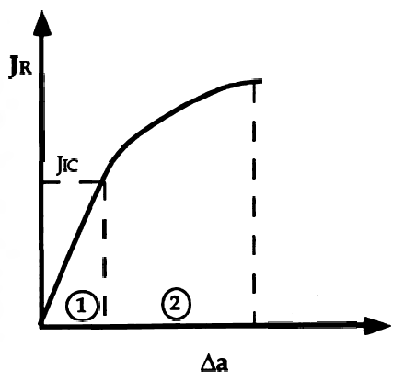
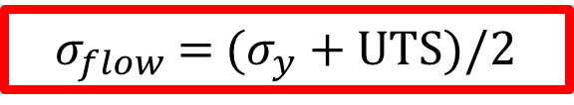

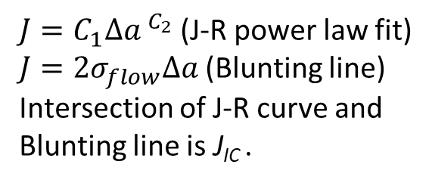
Motivation
What are the Elastic properties of UHMWPE?
What are the post yield properties of UHMWPE?
What are the fracture toughness properties of UHMWPE?
E = 117 to 2020 MPa?
Ultimate Tensile Stress = 33 to 200 MPa
$σ_{flow}$ = ($σ_{y}$ + UTS)/2
$$K_{JIC}=\sqrt{\frac{E}{(1−ν^{2})}J_{IC}}$$
$J=C_{1}{∆a }^{C_{2}}$ (J-R power law fit)
$J=2σ_{flow}∆a$ (Blunting line)
Intersection of J-R curve and
Blunting line is J_{IC} .
(Kurtz et al. Biomaterials 1998)
(Gomoll et al. JORS 2002)
(Bergstrom et al., 2003 Biomaterials)
(Oral et al., 2006 Biomaterials)
(Atwood et al., 2011 JMBBM)
(Bellare et al. JMBBM 2016)
(Ansari et al. JMBBM 2016)
(Anderson Fracture Mechanics)

Slide 4
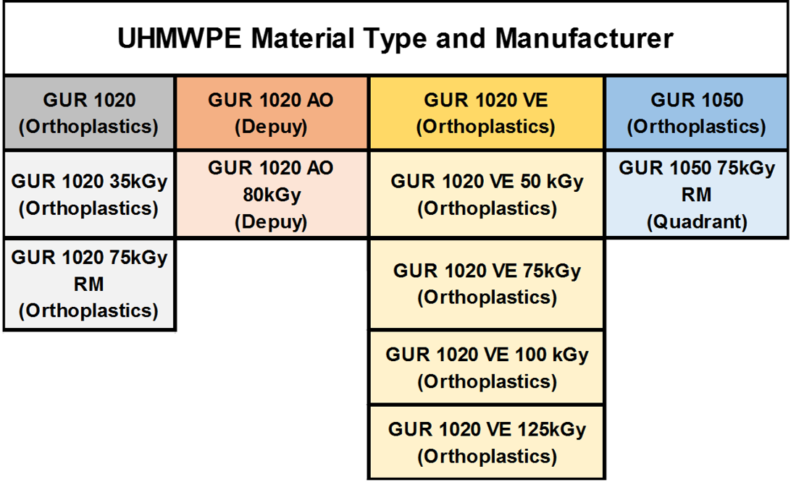

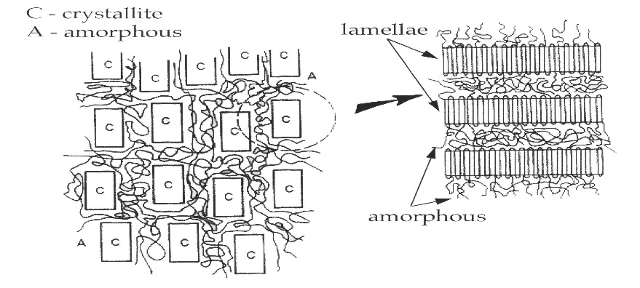
2 resins (1020/1050)
Range of crosslinking
(Doses: 35-125 kGy)
2 antioxidants:
AO and VE

Slide 5
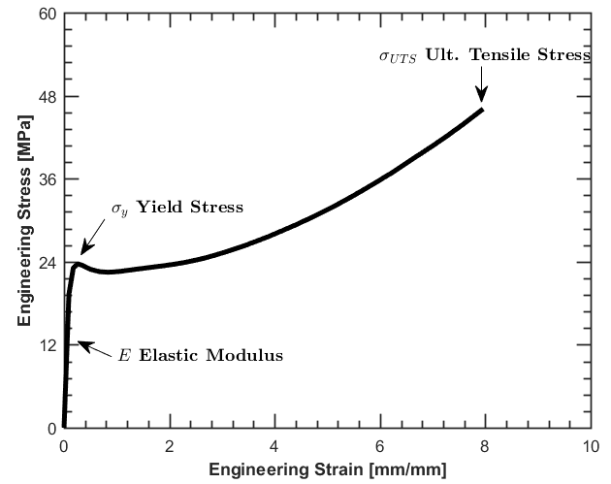
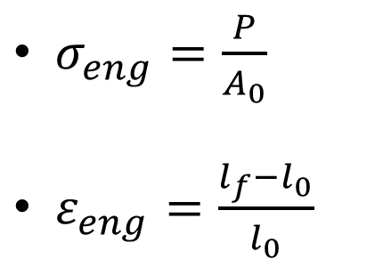
Methods: Tensile Testing (Engineering)
GUR 1020
$σ_{eng}=\frac{P}{A_{0}}$
$ε_{eng}=\frac{l_{f}−l_{0}}{l_{0}}$
ASTM D638 Type IV tensile specimens (n=5) @ 25°C
50 mm/min disp rate
Fracture properties depend on Engineering Ultimate Stress
(Kurtz et al., 1998 Biomaterials)
(Rimnac et al., 1988 PES)

Slide 6
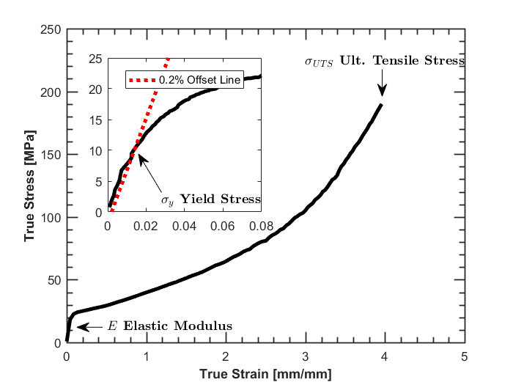

Methods: Tensile Testing (True)
${dε}_{true}= \frac{dl}{l}$
$σ_{true}=\frac{P}{A_{i}}$
GUR 1020
ASTM D638 Type IV tensile specimens (n=5) @ 25°C, 50mm/min disp rate.
Dual video extensometer for true stress-strain.
0.2% offset yield for comparison to compression
(Kurtz et al., 1998 Biomaterials)
(Kurtz et al., 2002 Biomaterials)
(Kurtz et al., 2006 Biomaterials)
(Rimnac et al., 1988 PES)

Slide 7
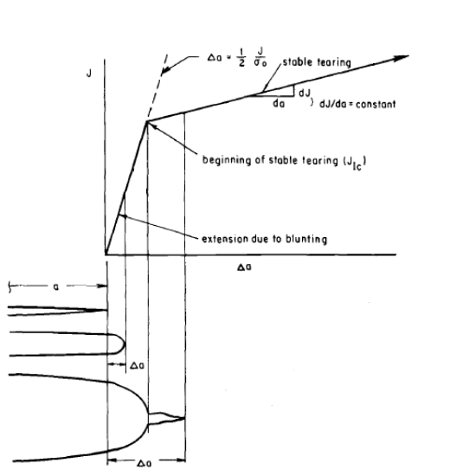
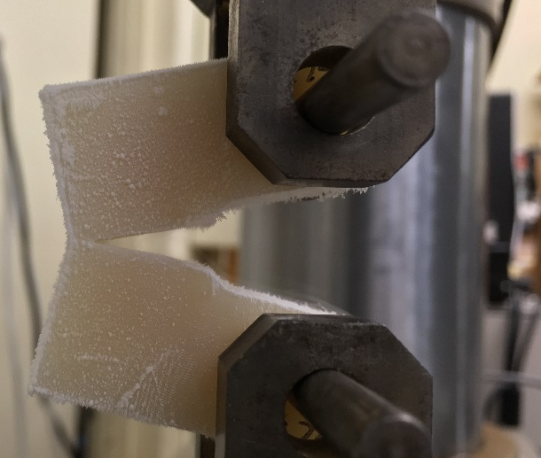
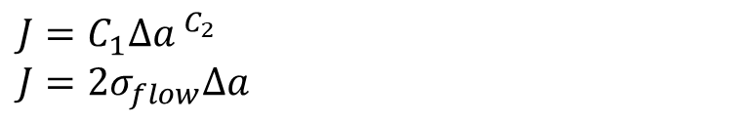

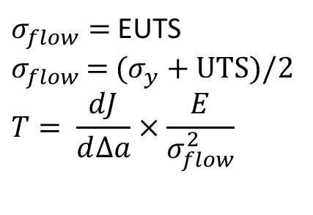
Methods: Fracture Toughness
$σ_{flow}=$ EUTS
$σ_{flow}$ = ($σ_{y}$ + UTS)/2
$$T= \frac{dJ}{d∆a}×\frac{E}{σ_{flow}^{2}}$$
$$J=\frac{ηU}{B(W−a_{0})}$$
$$J=C_{1}{∆a }^{C_{2}}$$
$$J=2σ_{flow}∆a$$
J-R curves using ASTM D6068 and E1820.
1mm/min displacement rate @25°C.
(Paris 1979 ASTM)
C(T) specimens W=31.75mm, B=15.9mm

Slide 8
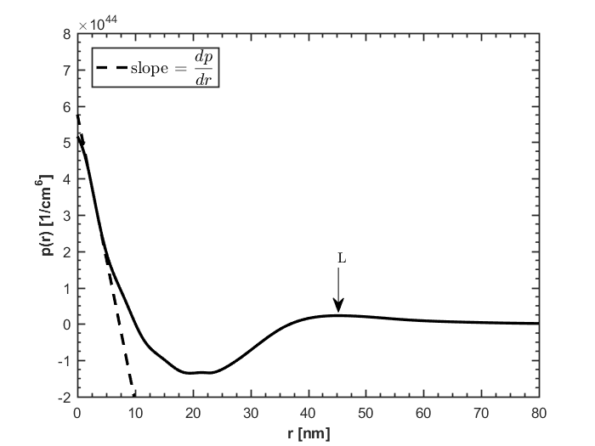
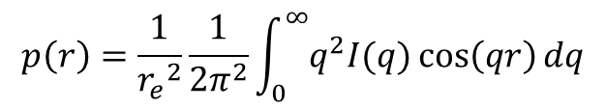
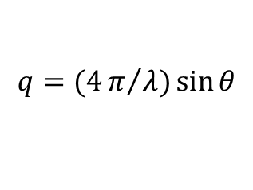
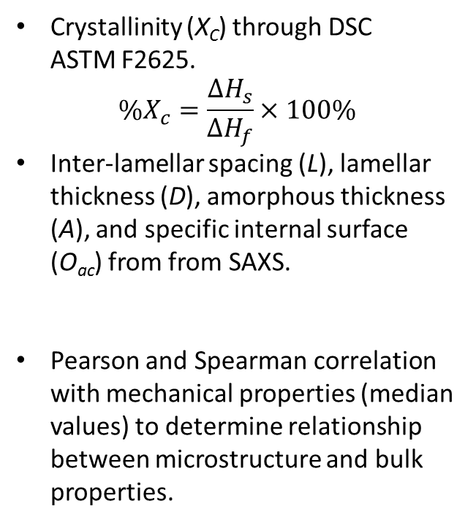
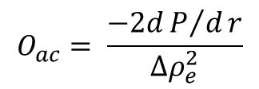

Methods: Microstructure
Crystallinity (X_{C}) through DSC ASTM F2625.
$$\%X_{c}=\frac{∆H_{s}}{∆H_{f}}×100\%$$
Inter-lamellar spacing (L), lamellar thickness (D), amorphous thickness (A), and specific internal surface (O_{ac}) from from SAXS.
Pearson and Spearman correlation with mechanical properties (median values) to determine relationship between microstructure and bulk properties.
(Turell & Bellare 2004 Biomaterials)
$$p\left(r\right)=\frac{1}{{r_{e}}^{2}}\frac{1}{2π^{2}}\int_{0}^{∞}{q^{2}I(q)\cos\left(qr\right)dq}$$
$$q=(4π/λ)\sin{θ}$$
(Atwood et al., 2011 JMBBM)
$$O_{ac}= \frac{−2dP/dr}{∆ρ_{e}^{2}}$$
$$D=X_{C}L$$

Slide 9
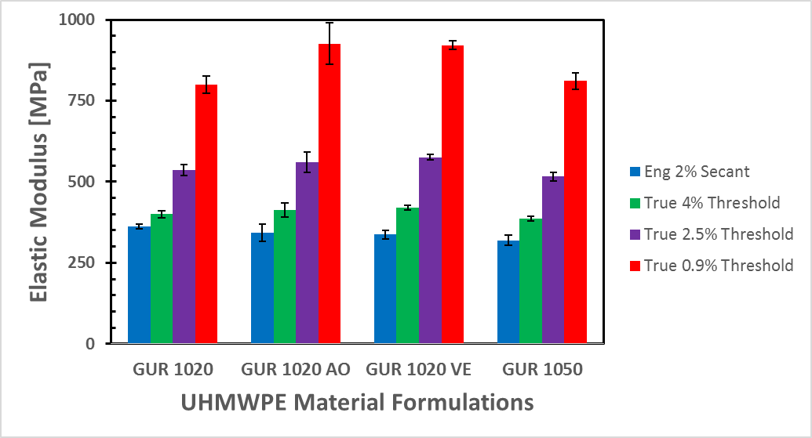
Results: Tensile Stress Strain
Method can elucidate or hide material properties!!!
Linear regression from 0.0005 to 0.009 true strain produces largest difference between moduli of UHMWPE material formulations.
Highest R² values produced this way (0.95-0.99).
Relative STD is not increased using this method.
(Oral et al., 2006 Biomaterials)
(Atwood et al., 2011 JMBBM)

Slide 10
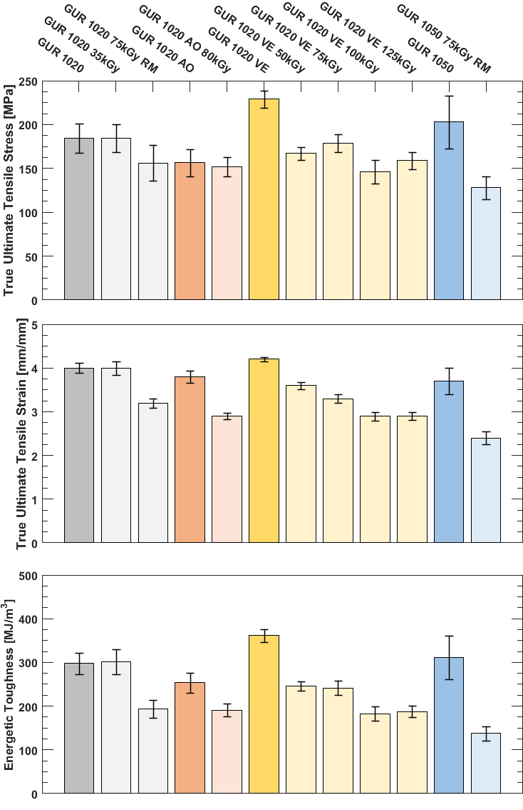

True Ultimate Tensile Stress decreases with cross-linking dosage in each material group.
True Ultimate Tensile Strain decreases with cross-linking dosage in each material group.
Energetic Toughness (ET) decreases with cross-linking dosage in each material group.

Slide 11
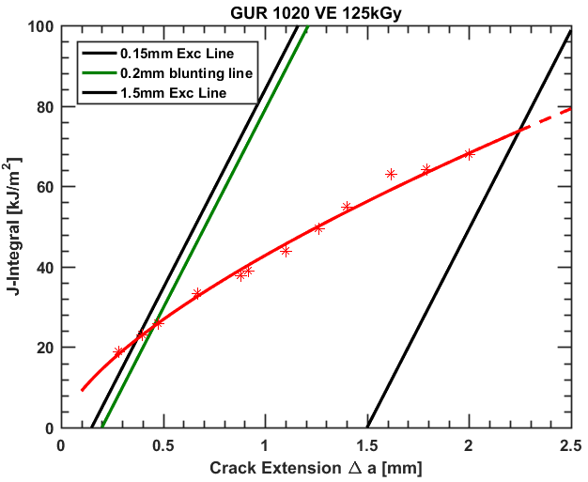
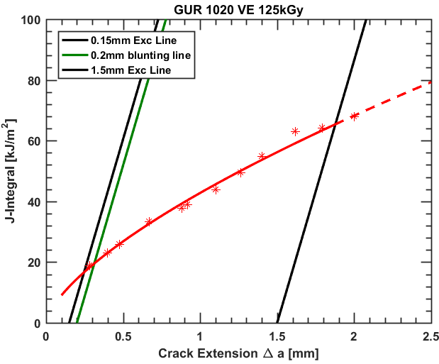



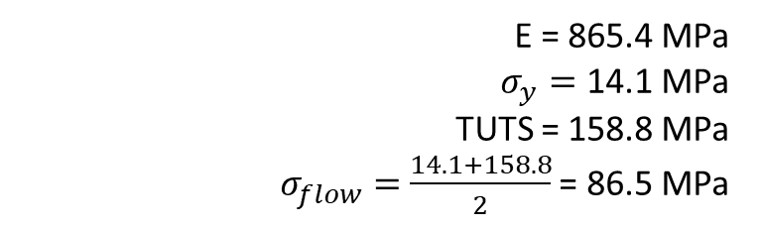

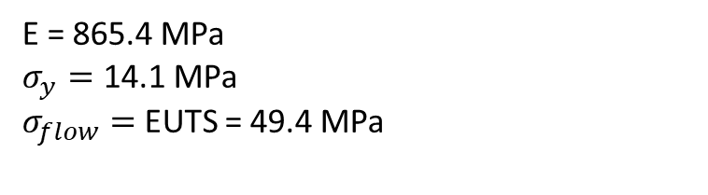

Results: Fracture Toughness
$$J=C_{1}{∆a }^{C_{2}}$$
$$J_{q}$$
$$J=C_{1}{∆a }^{C_{2}}$$
$$J_{q}$$
E = 865.4 MPa
$σ_{y}=$ 14.1 MPa
$σ_{flow}=$ EUTS = 49.4 MPa
E = 865.4 MPa
$σ_{y}=$ 14.1 MPa
TUTS = 158.8 MPa
$σ_{flow}=$ $\frac{14.1+158.8}{2}$ = 86.5 MPa
$$J=2σ_{flow}∆a$$
$$B,b_{0}≥17\frac{J_{q}}{σ_{flow}}$$
(Rimnac et al., 1988 PES)
(Pascaud et al., 1997 PES)
(ASTM E1820)

Slide 12
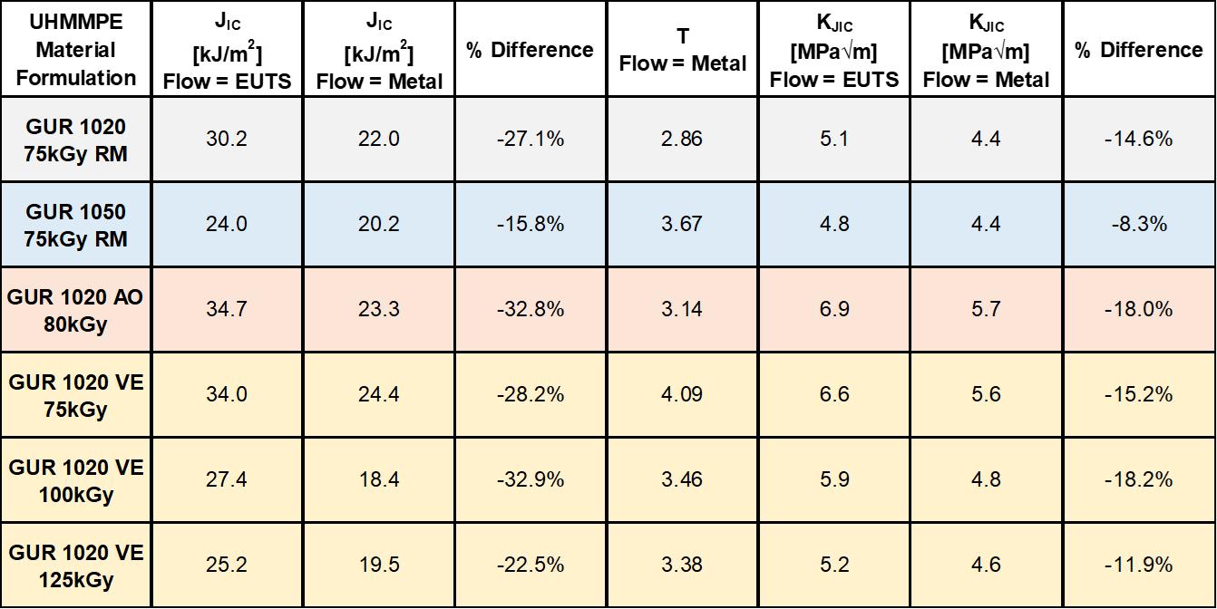

$$K_{JIC}=\sqrt{\frac{E}{(1−ν^{2})}J_{IC}}$$
Results: Fracture Toughness
It’s all about the METHOD!
Tearing Modulus (T) (Flow=Metal), no real change between blends
K_{JIC} (Flow=Metal) ranges between 4.4 to 5.7 MPa√m
Varadarajan and Rimnac found differences of -45% to -30% between J_{minQ} from CTOD versus J_{Q} from blunting line for cross-linked UHMWPE
(Varadarajan & Rimnac 2008 Polymer)

Slide 13
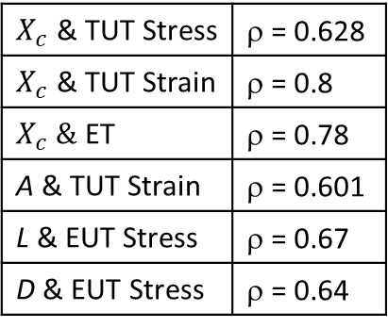
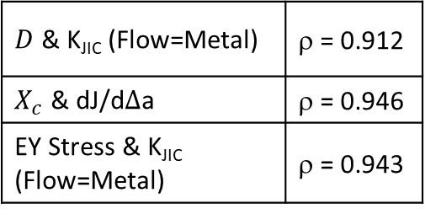
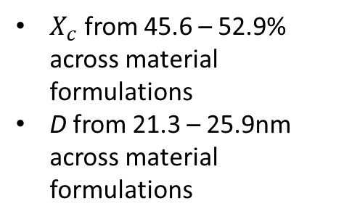
Results: Microstructure & Correlations
$X_{c}$ from 45.6 – 52.9% across material formulations
D from 21.3 – 25.9nm across material formulations
Spearman Rank Correlation
$X_{c}$ & TUT Stress | ρ = 0.628
$X_{c}$ & TUT Strain | ρ = 0.8
$X_{c} \&$ ET | ρ = 0.78
A & TUT Strain | ρ = 0.601
L & EUT Stress | ρ = 0.67
D & EUT Stress | ρ = 0.64
p ≤ 0.05 (all correlations using median values)
$D$ & K_{JIC} (Flow=Metal) | ρ = 0.912
$X_{c}$ & dJ/dΔa | ρ = 0.946
EY Stress & K_{JIC} (Flow=Metal) | ρ = 0.943
Pearson Correlation Coefficient
Spearman Rank Correlation
(Atwood et al., 2011 JMBBM)

Slide 14
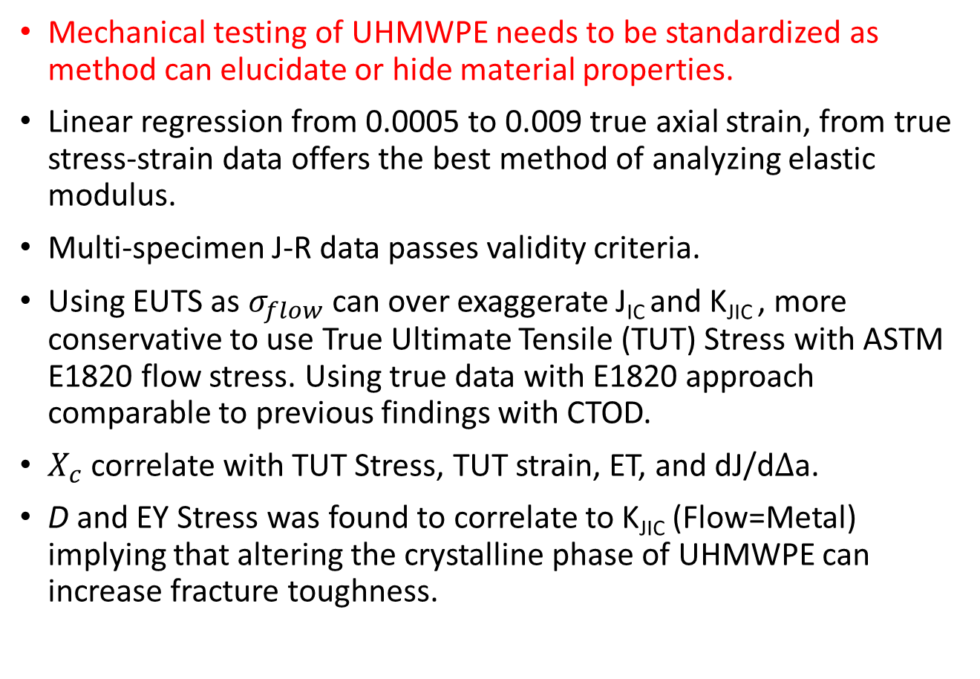
Conclusions
Mechanical testing of UHMWPE needs to be standardized as method can elucidate or hide material properties.
Linear regression from 0.0005 to 0.009 true axial strain, from true stress-strain data offers the best method of analyzing elastic modulus.
Multi-specimen J-R data passes validity criteria.
Using EUTS as $σ_{flow}$ can over exaggerate J_{IC} and K_{JIC} , more conservative to use True Ultimate Tensile (TUT) Stress with ASTM E1820 flow stress. Using true data with E1820 approach comparable to previous findings with CTOD.
$X_{c}$ correlate with TUT Stress, TUT strain, ET, and dJ/dΔa.
D and EY Stress was found to correlate to K_{JIC} (Flow=Metal) implying that altering the crystalline phase of UHMWPE can increase fracture toughness.
(Varadarajan & Rimnac 2008 Polymer)

Slide 15
Acknowledgements
We would like to thank Orthoplastics, Quadrant and DePuy for supplying materials
Funding for this research was provided by the Lawrence Talbot Professorship endowment, and the Ian Finnie graduate mechanical behavior of engineering materials fellowship.

