Slide 1
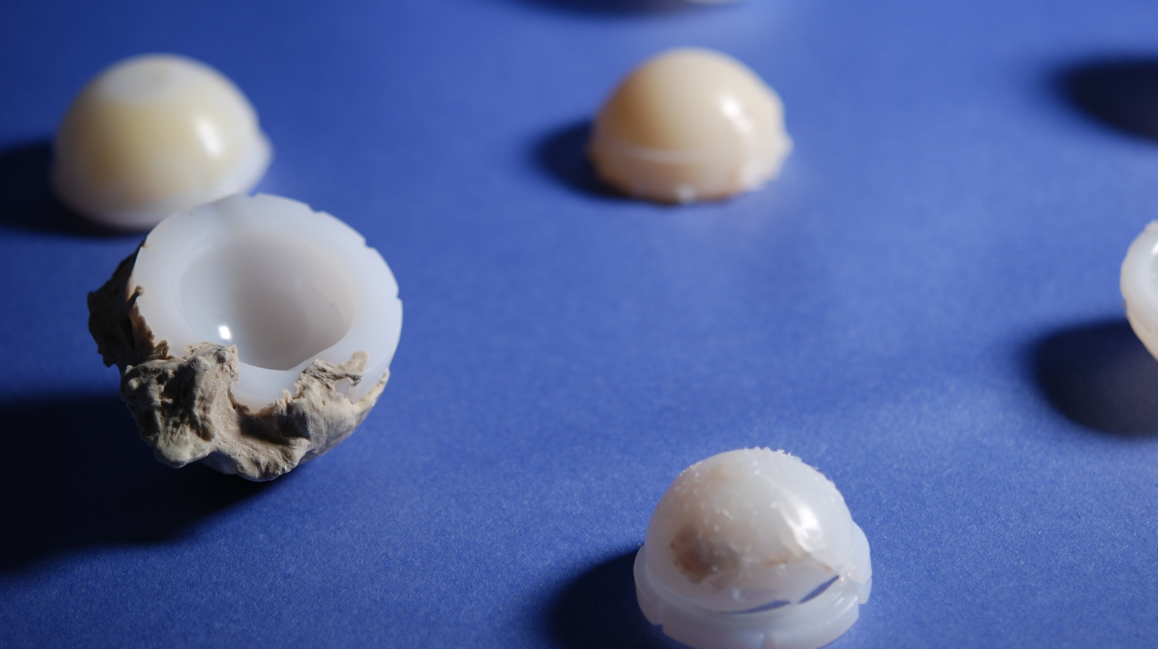
Long-Term In Vivo Degradation of 1st Generation Highly Crosslinked Polyethylene in THA
Jaclyn Schachtner, Daniel W. MacDonald, Gregg Klein, Antonia Chen, Matthew Kraay, Arthur Malkani, Michael Mont, Clare Rimnac, and Steven M. Kurtz

Slide 2


NIH R01 AR47904
Institutional Support from:
Smith & Nephew; Stryker; Zimmer; Biomet; Depuy Synthes; Medtronic; Invibio; Stelkast; Formae; Kyocera Medical; Wright Medical Technology; Ceramtec; DJO; Celanese; Aesculap; Simplify Medical; Active Implants

Slide 3
Introduction
Highly crosslinked polyethylene (HXLPE)
  Introduced in 1998
  Improves wear resistance and reduces osteolysis
Irradiation induced crosslinking
  Produces free radicals

Slide 4
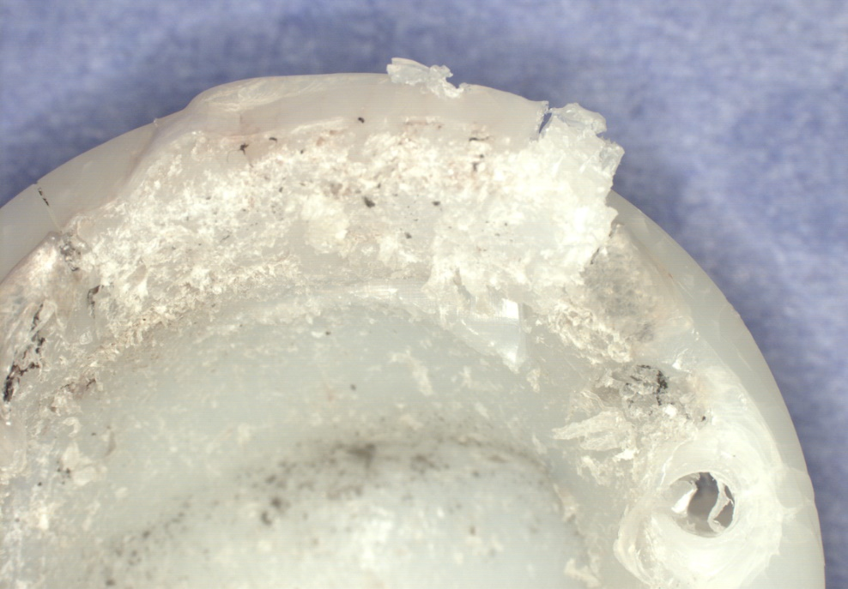
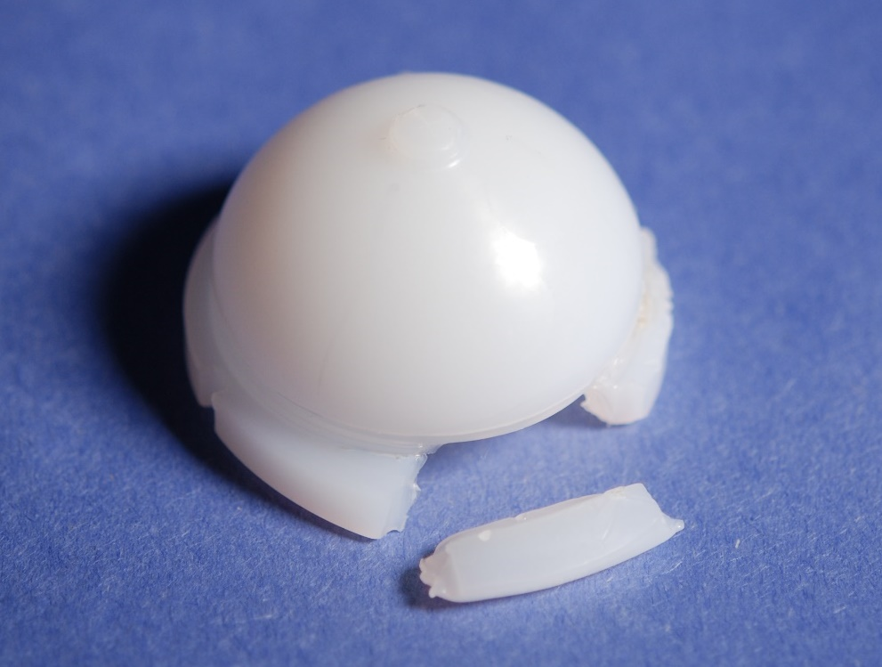
Introduction
Annealed
  Free radicals are detectable
Remelted
  Post-irradiation temperature reduces fatigue strength
Annealed
Remelted

Slide 5
Study Questions
How well does long-term HXLPE decrease wear and osteolysis?
Is there a difference in performance of the two post-irradiation methods of 1st generation HXLPE?
Notes:
Change perform

Slide 6
Inclusion Criteria
1,112 HXLPE acetabular liners
317 were not 1st generation
795 acetabular liners
144 were not Crossfire or Longevity
651 acetabular liners
523 were implanted <5 years
  5 liners were excluded due to site restrictions and device design
128 1st generation
123 Total Components

Slide 7
1st Generation Patient Demographics
 | Cohort | n | Age (years) | Gender (%F) | BMI (kg/m²) | Implantation Time (y) | Max UCLA Score
Annealed | Intermediate-Term (5-10y) | 29 | 57.6 ± 15 | 62% | 31.4 ± 6.5 | 7.3 ± 1.7 | 6 (1 – 8)
 | Long-Term (10+y) | 21 | 54.4 ± 17 | 40% | 29.0 ± 3.0 | 12.2 ± 1.8 | 7 (3 – 10)
Remelted | Intermediate-Term (5-10y) | 60 | 57.6 ± 14 | 52% | 29.8 ± 6.9 | 7.2 ± 1.2 | 6 (2 – 10)
 | Long-Term (10+y) | 14 | 52.4 ± 10 | 64% | 28.2 ± 3.7 | 11.4 ± 1.3 | 6 (2 – 9)

Slide 8
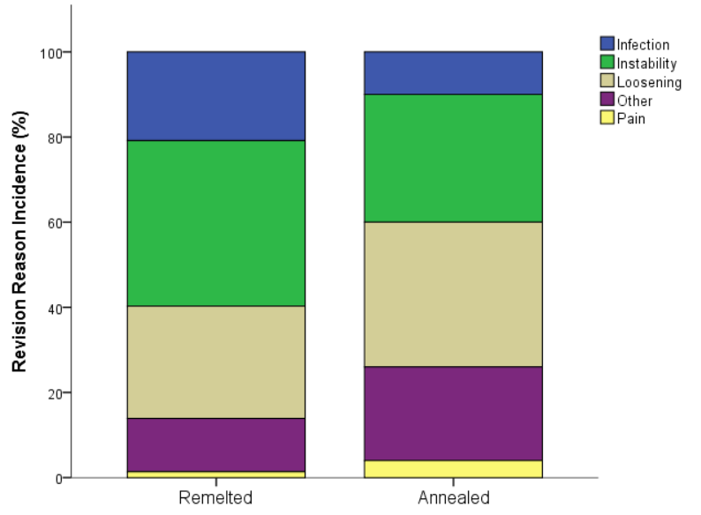
Reasons for Revision (>5y)
Notes:
What does other include: fracture, malposition, PW wear

Slide 9
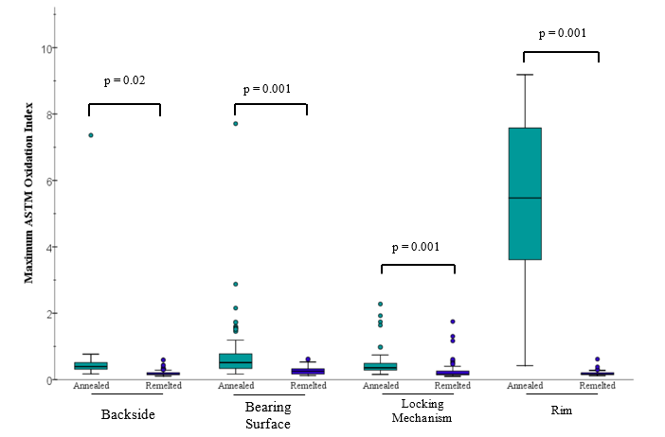
Oxidation

Slide 10
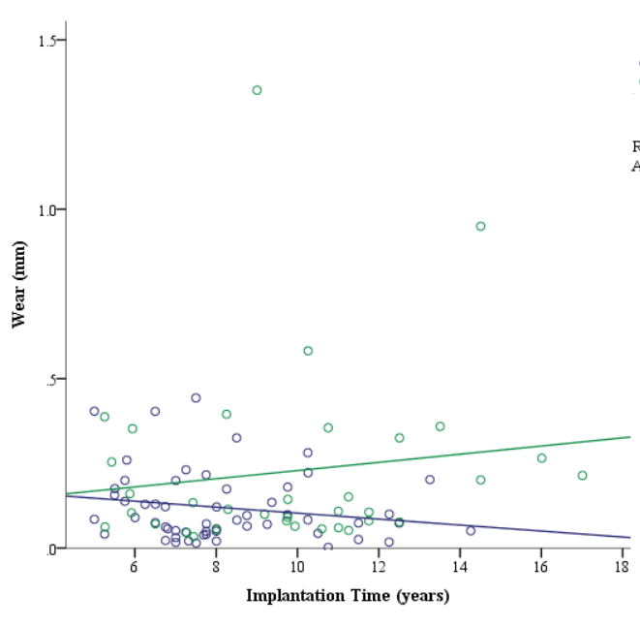
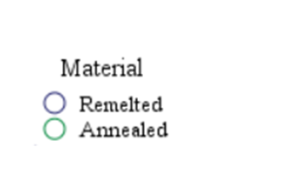
Femoral Head Penetration Rates
Penetration rates were statistically similar between the two cohorts (p = 0.11).
*Measured 92 liners
Notes:
Annealed mean = 0.02 (n=35)
Remelted mean = 0.016 (n=57)
No difference
Includes x out of y liners

Slide 11
Survival Analysis – UCLA Score
Low UCLA: 1 – 5
High UCLA: 6 – 10
Categories were significantly different (p = 0.042).
Notes:
Tested: age, head size, BMI, gender, UCLA

Slide 12
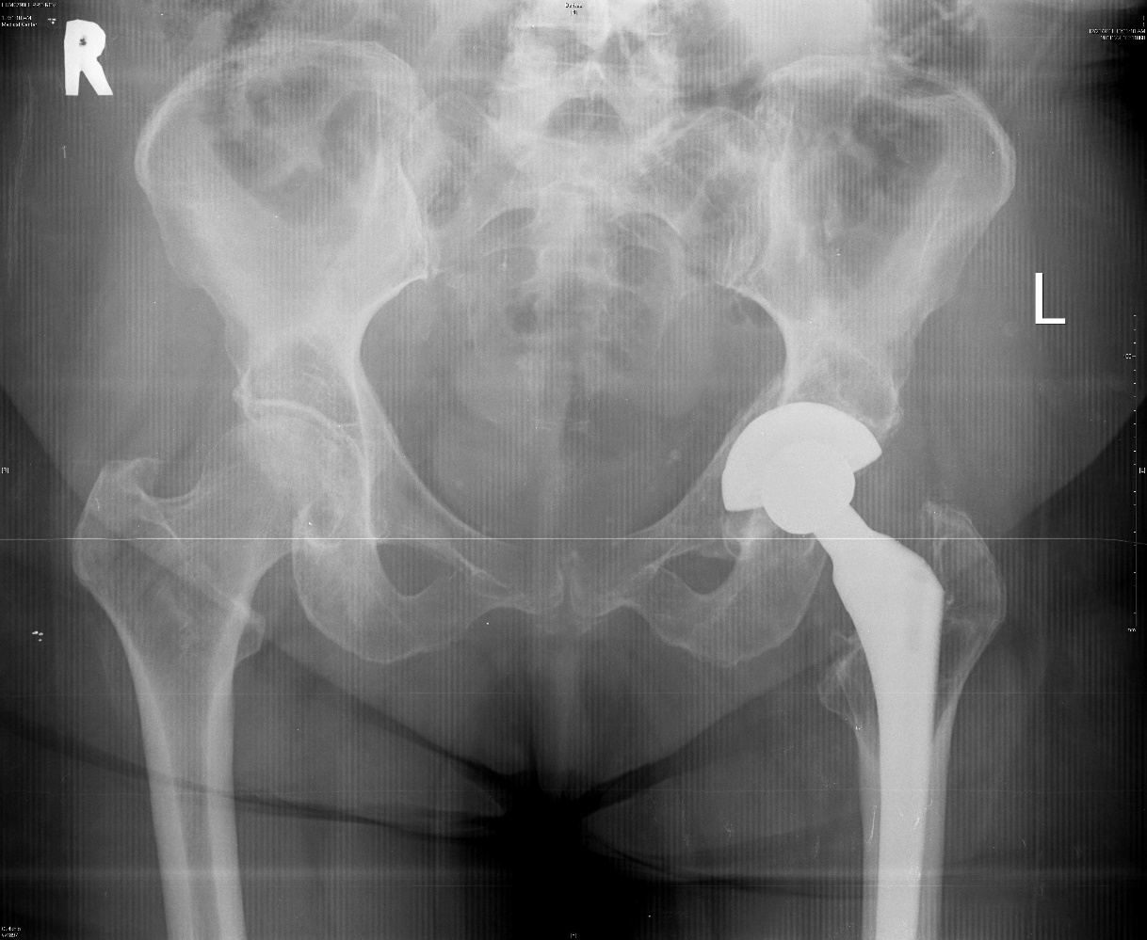
Osteolysis
How often is osteolysis occurring?
Notes:
humc-h0790
How often did it

Slide 13
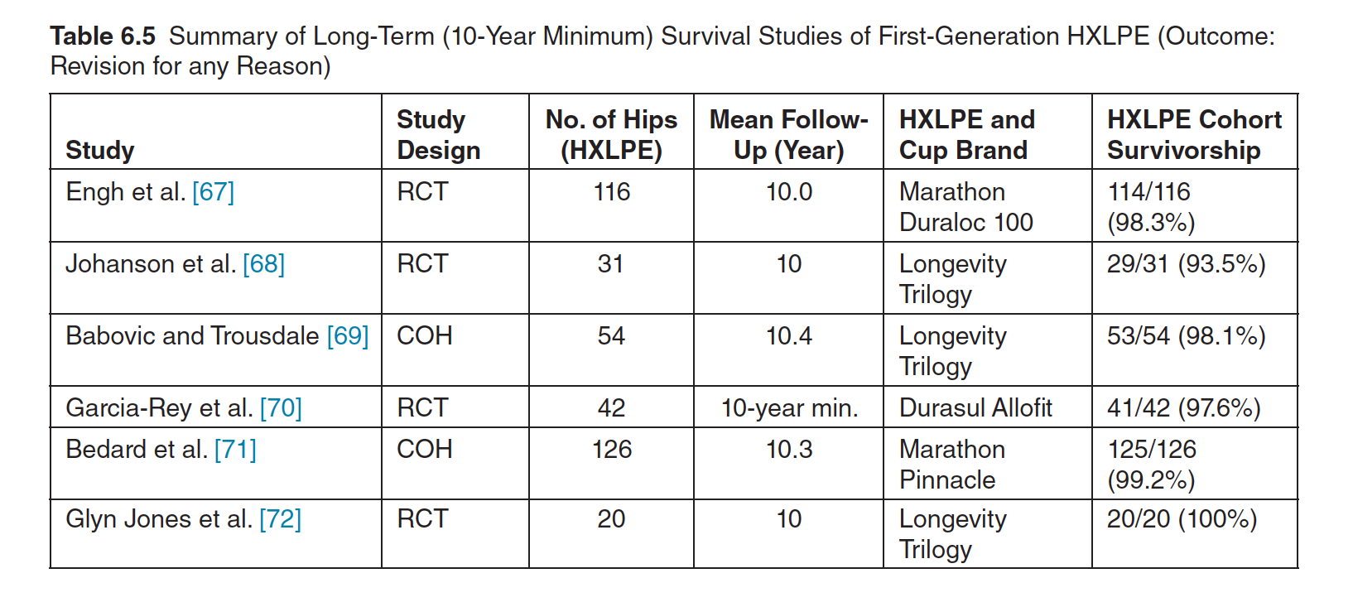
Survivorship
Source: Chapter 6, 3rd Edition of the UHMWPE Biomaterials Handbook, 2016
Notes:
3rd Edition of UHMWPE Handbook chapter 6

Slide 14
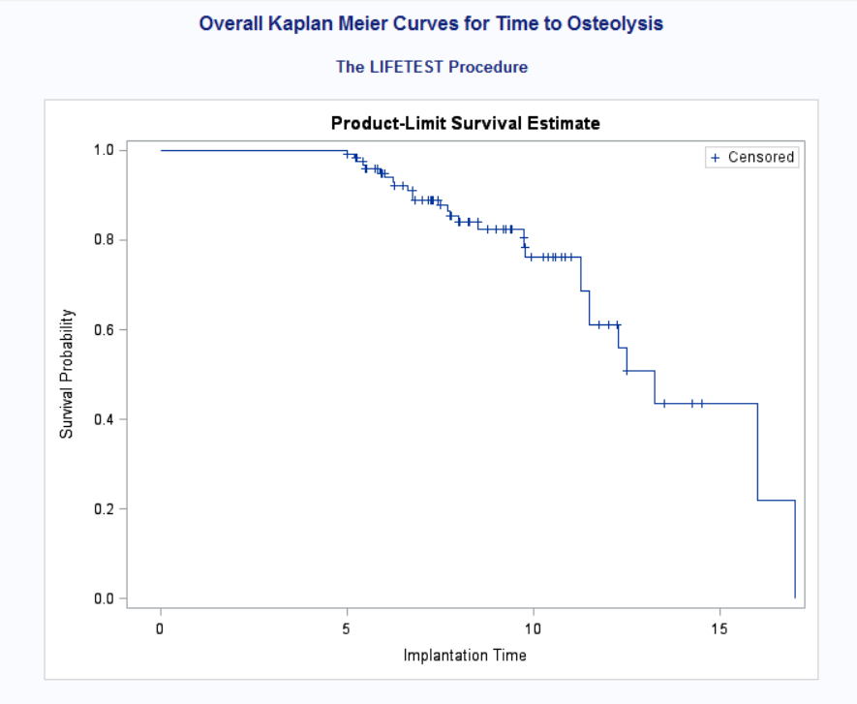
Survival Analysis - Osteolysis
Prevalence of osteolysis was found to be similar between the two materials (p = 0.29).

Slide 15
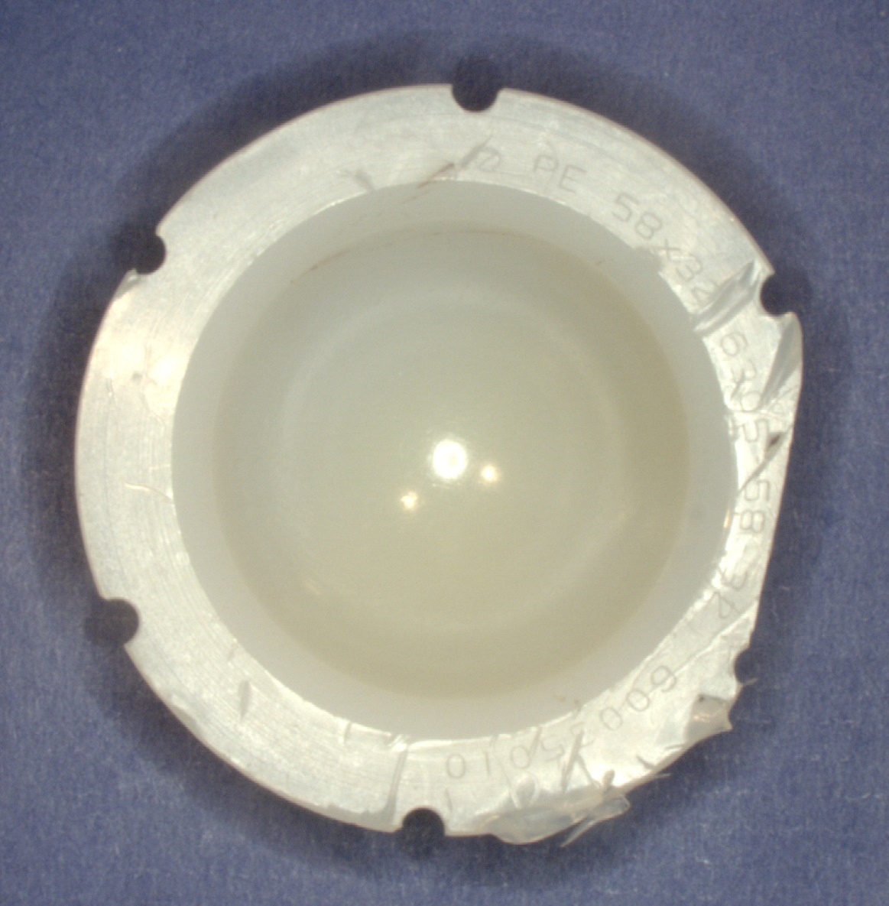
Case Study 1
Male, 60y
  BMI: 30.5 kg/m²
Implanted in 2003
Revised in 2011
  Max UCLA Score: 8
Revision Reason: Osteolysis
  Greater trochanter and acetabular capsule
In Vivo 7.75y
Notes:
HUMC-H0622
Add invivo time

Slide 16
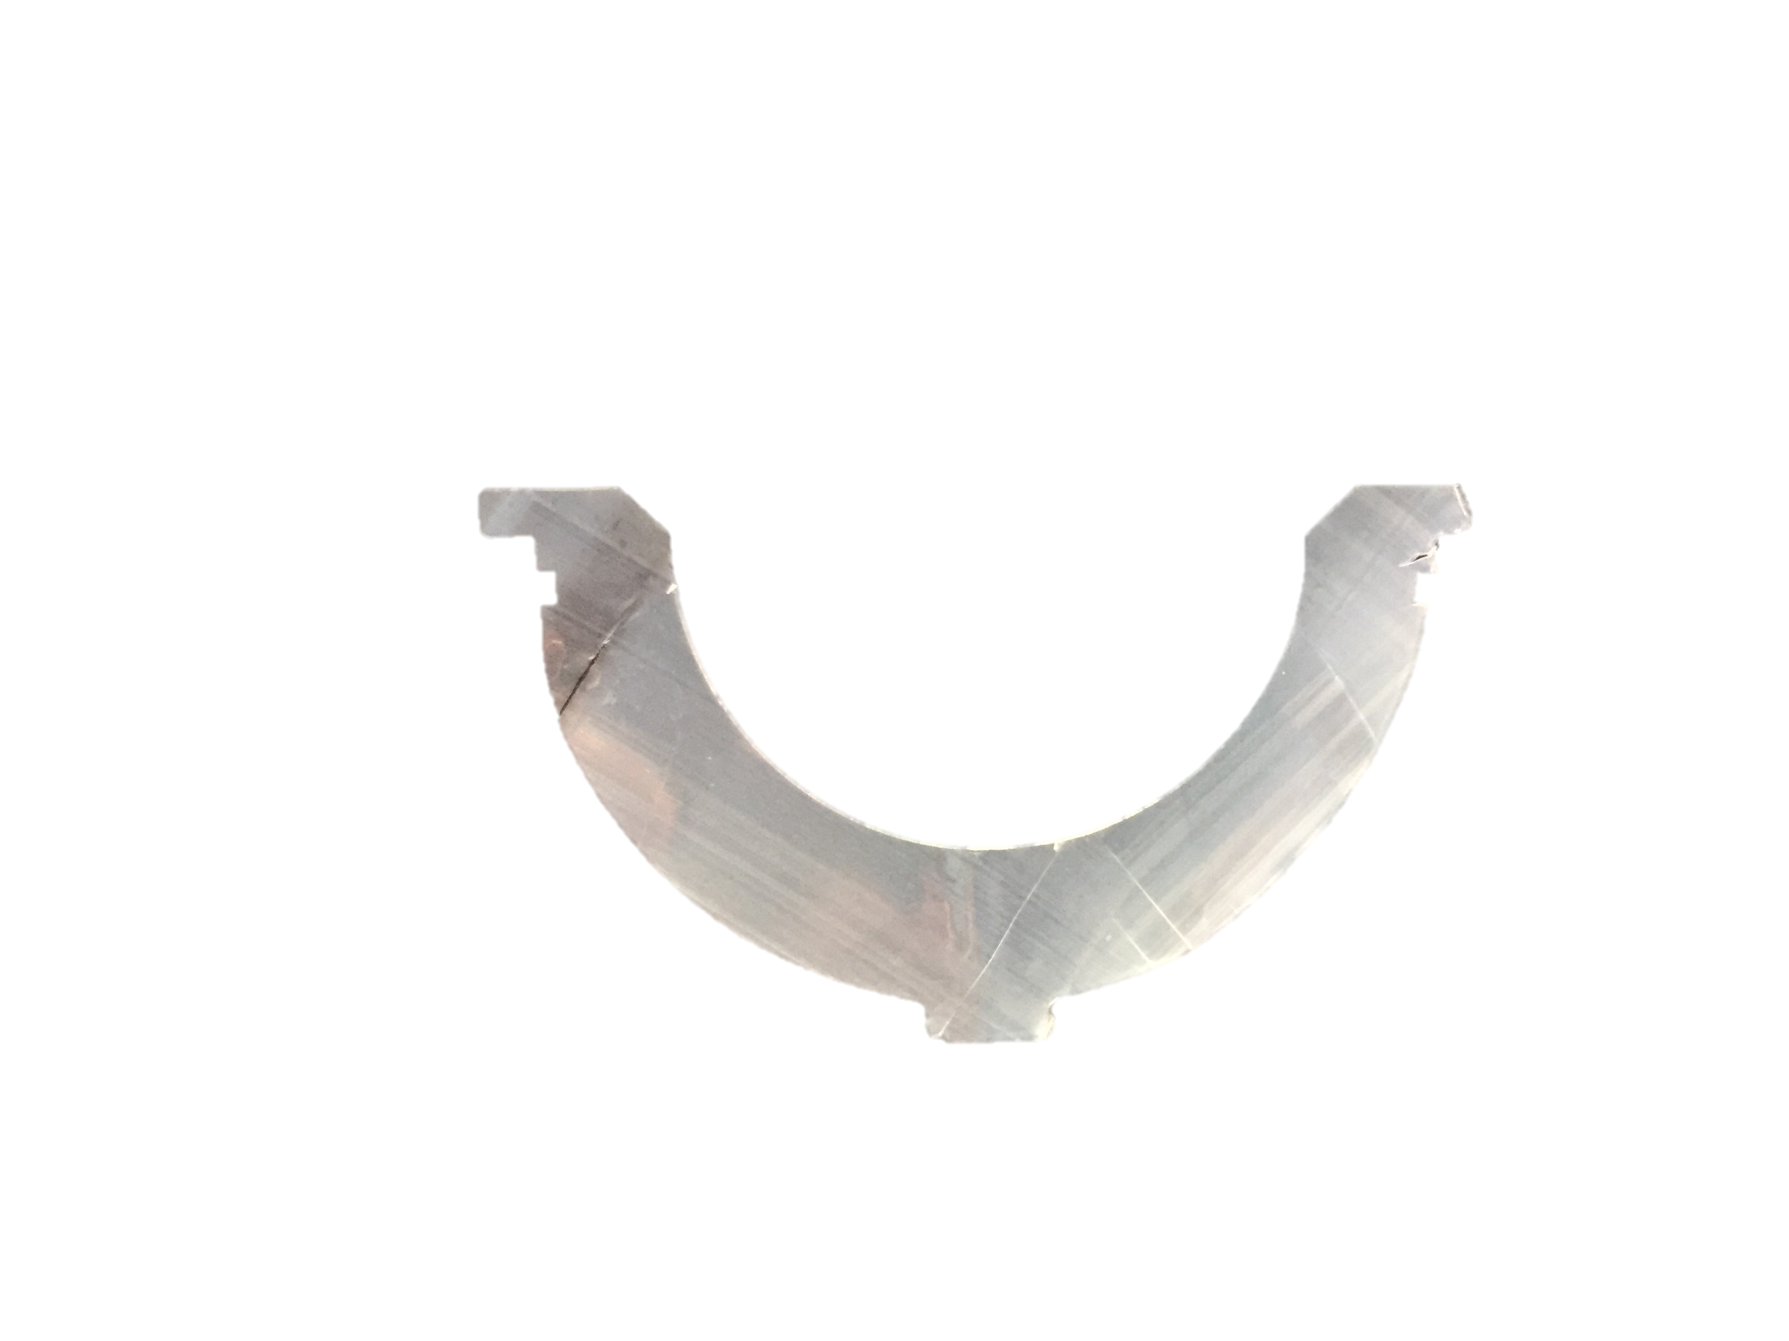
Superior Rim
OI_{Max}: 0.30
OI_{Max}: 0.30
OI_{Max}: 0.29
OI_{Max}: 0.31
OI_{Max}: 0.30
OI_{Max}: 0.29
OI_{Max}: 0.30
OI_{Max}: 0.30
Inferior Backside

Slide 17
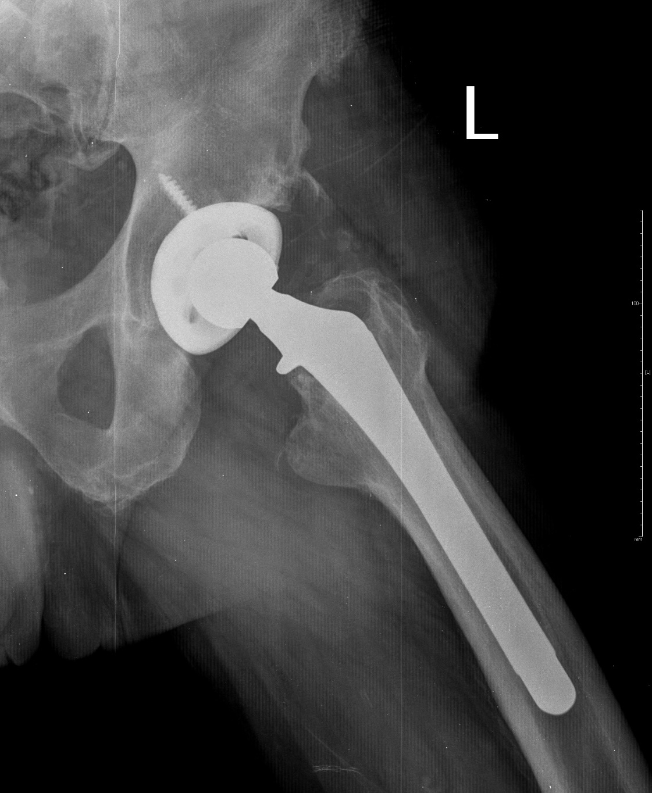
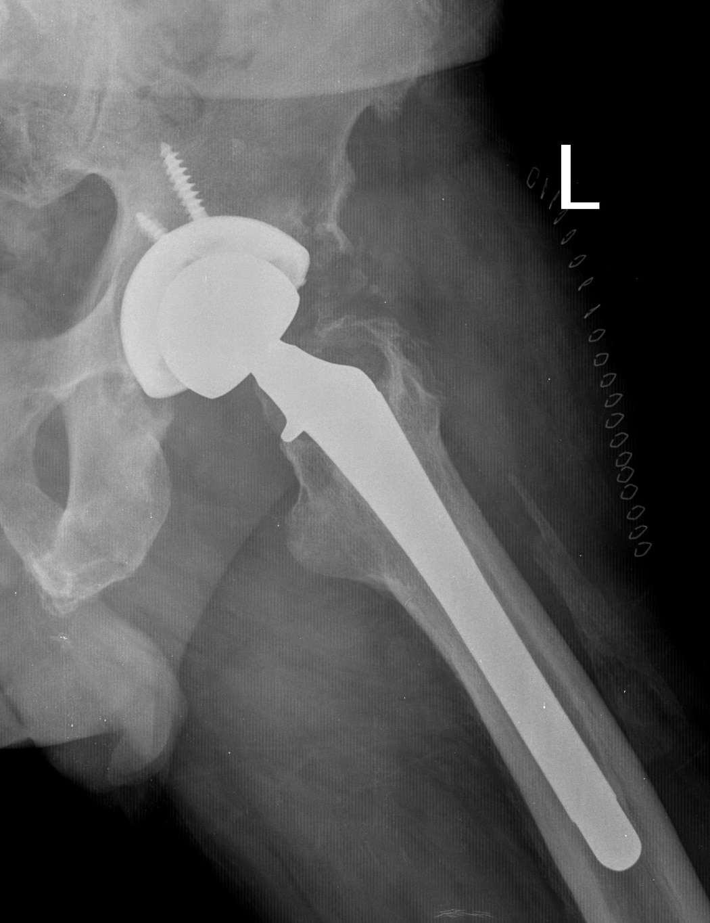
Radiographs
Pre-Revision
Post-Revision
Notes:
At implantation

Slide 18
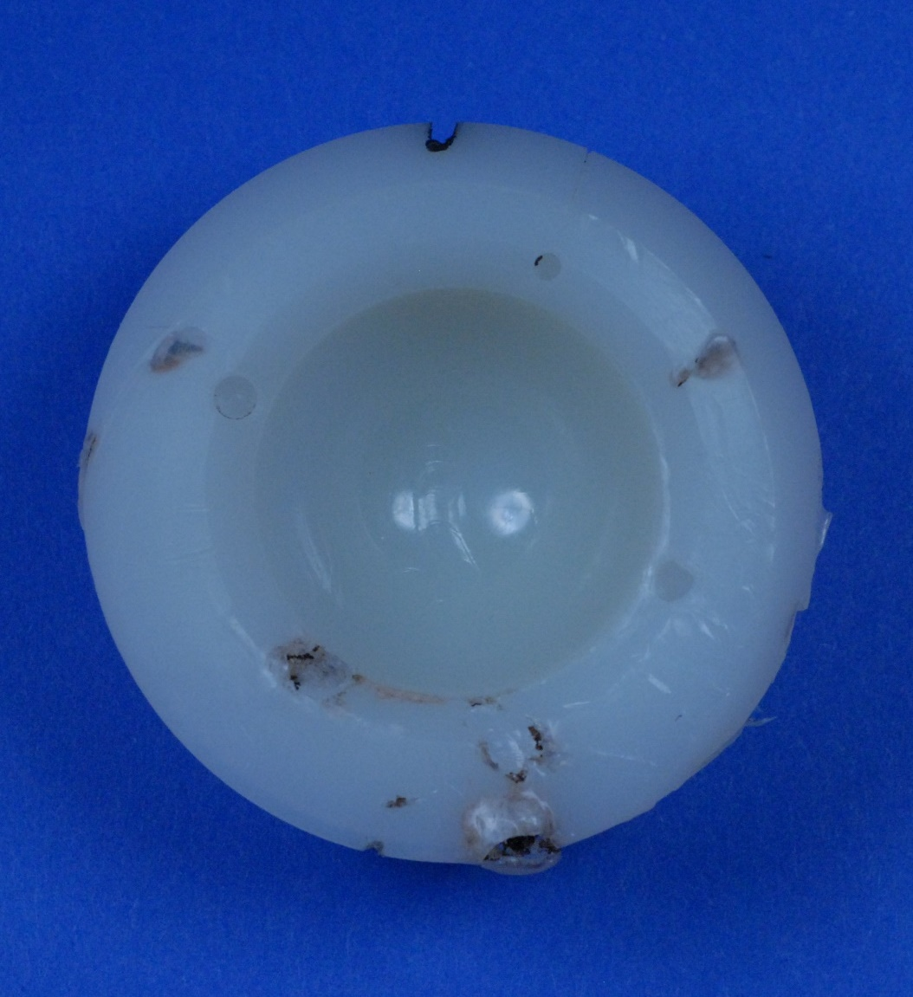
Case Study 2
Male, 42y
  BMI: 22.9 kg/m²
Implanted in 1999
Revised in 2009
  Max UCLA Score: 8
Revision Reason: Osteolysis
  Acetabulum
In Vivo 9.75y
Notes:
HUMC-H0362

Slide 19
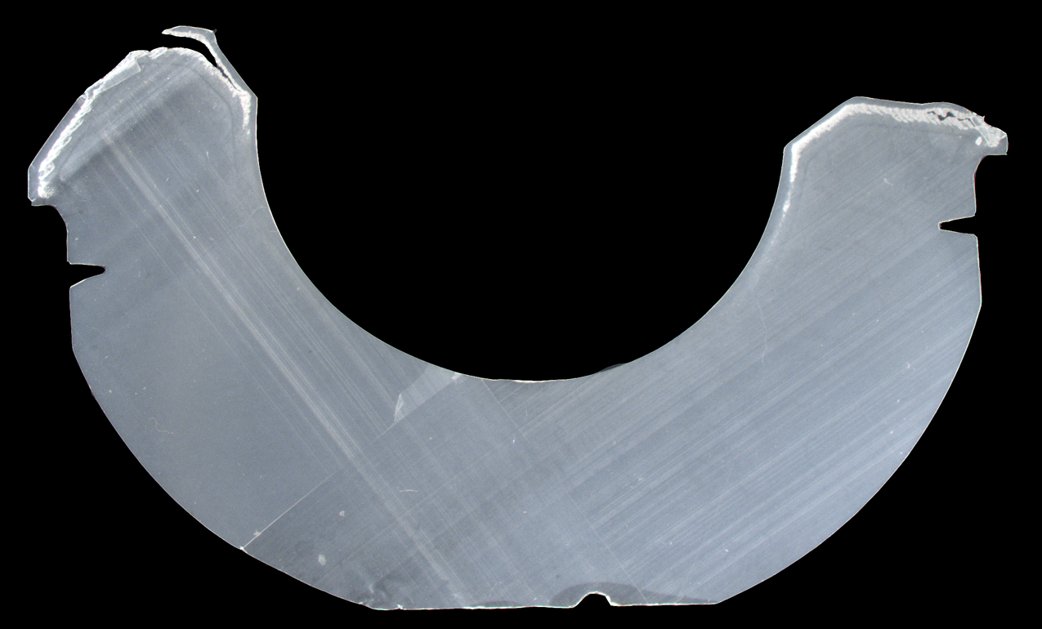
Superior Rim
OI_{Max}: 3.87
OI_{Max}: 6.51
OI_{Max}: 0.14
OI_{Max}: 0.10
OI_{Max}: 0.18
OI_{Max}: 0.43
OI_{Max}: 0.35
OI_{Max}: 0.15
Inferior Backside

Slide 20
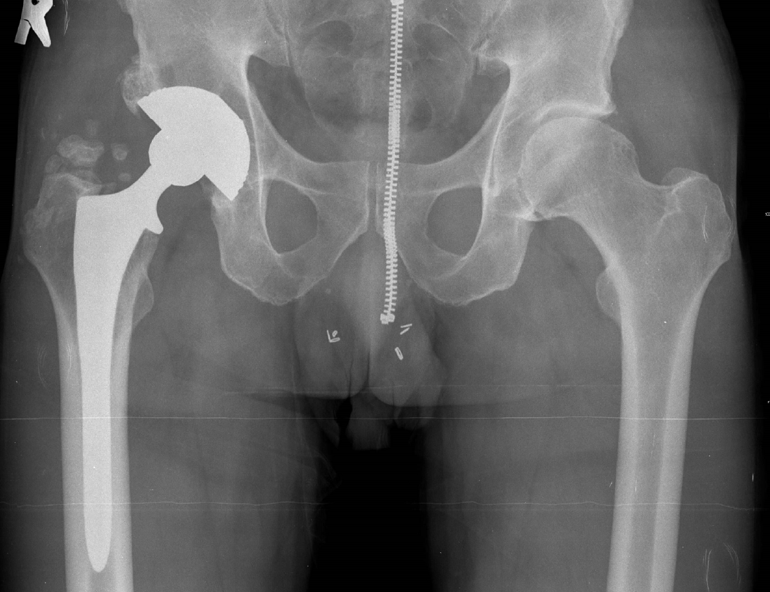
Radiographs
Pre-Revision

Slide 21
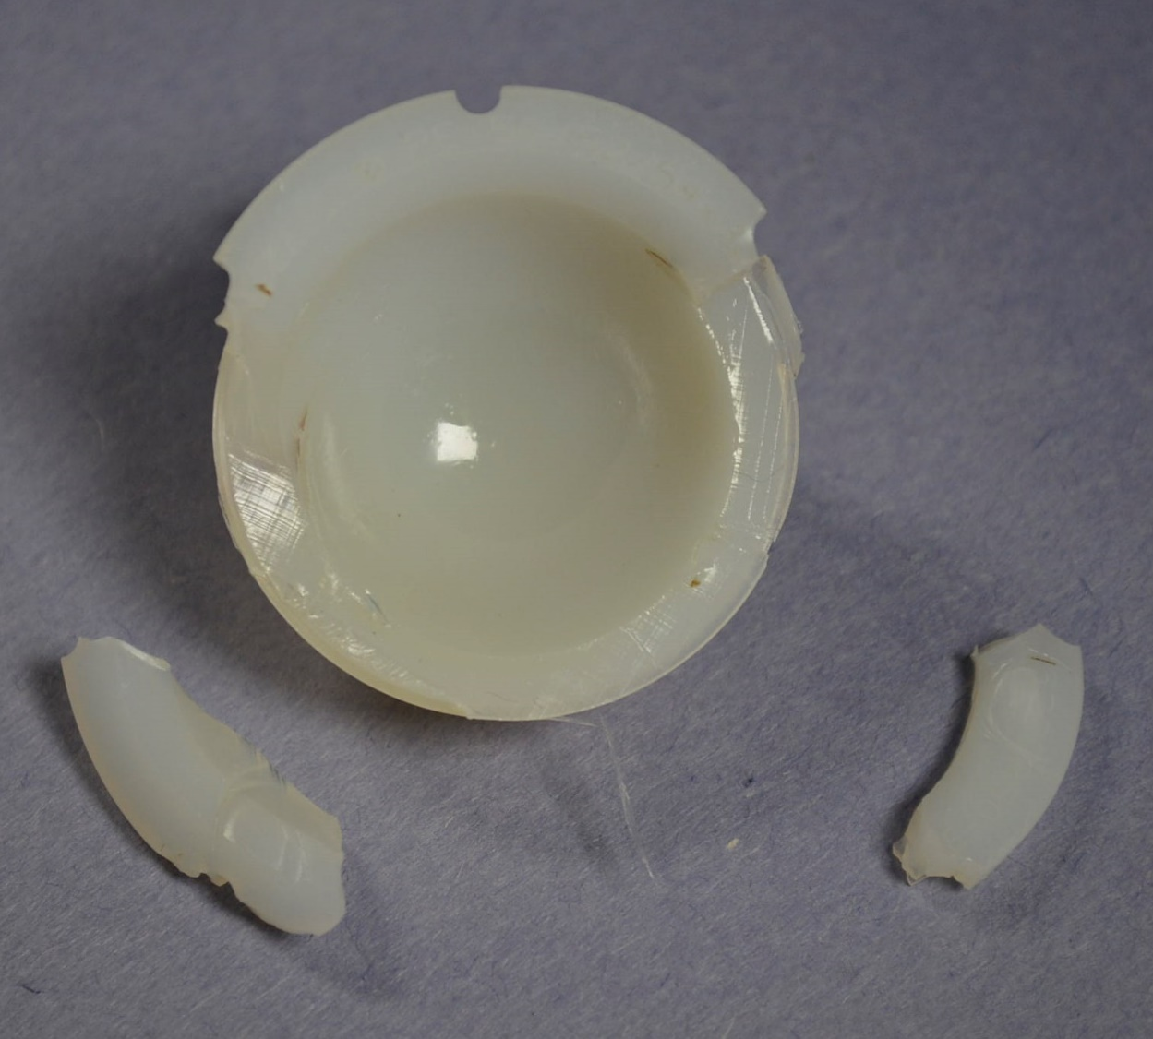
Case Study 3
Female, 43y
  BMI: 26.8 kg/m²
Implanted in 2005
Revised in 2017
  Max UCLA Score: 8
Revision Reason: Osteolysis
  About the ilium and lateral femoral shaft
In Vivo 11.5y
Notes:
HN-H0246

Slide 22
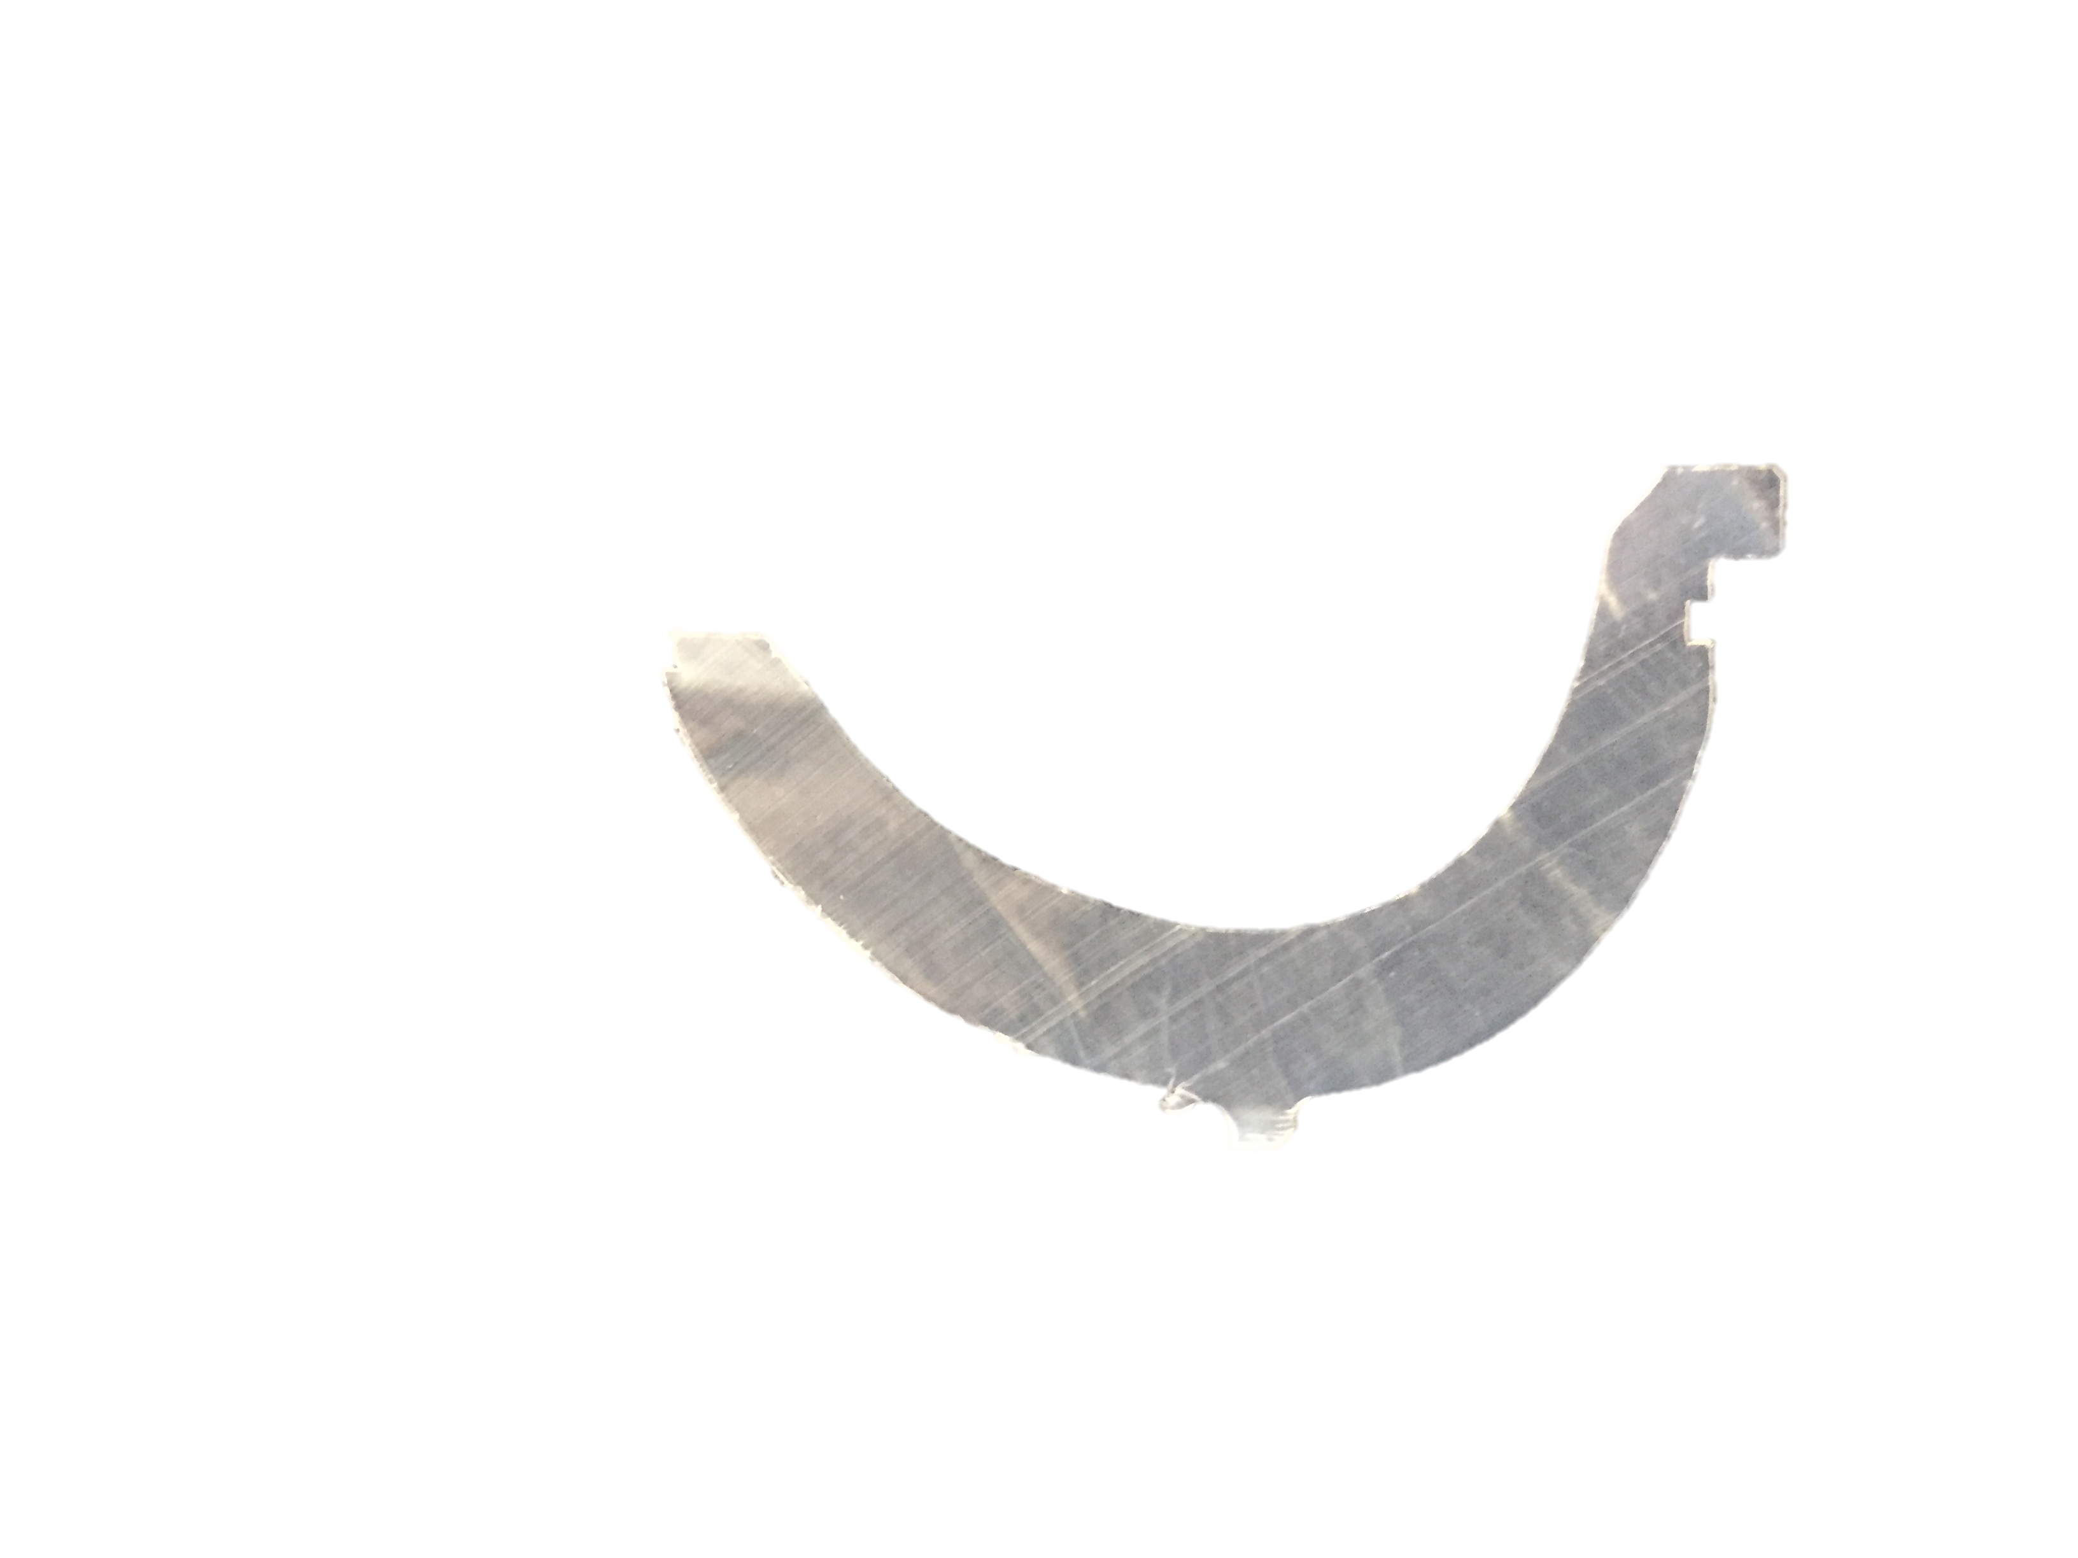
Superior Rim
OI_{Max}: 0.11
OI_{Max}: 0.08
OI_{Max}: 0.50
OI_{Max}: 0.28
OI_{Max}: 0.07
OI_{Max}: 0.05
OI_{Max}: 0.05
Inferior Backside

Slide 23
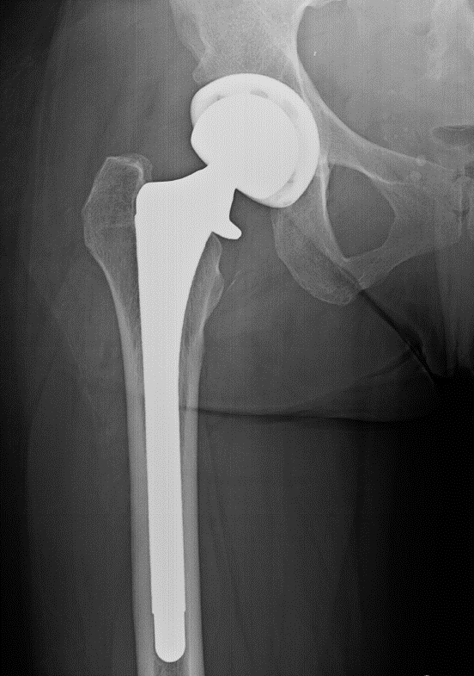
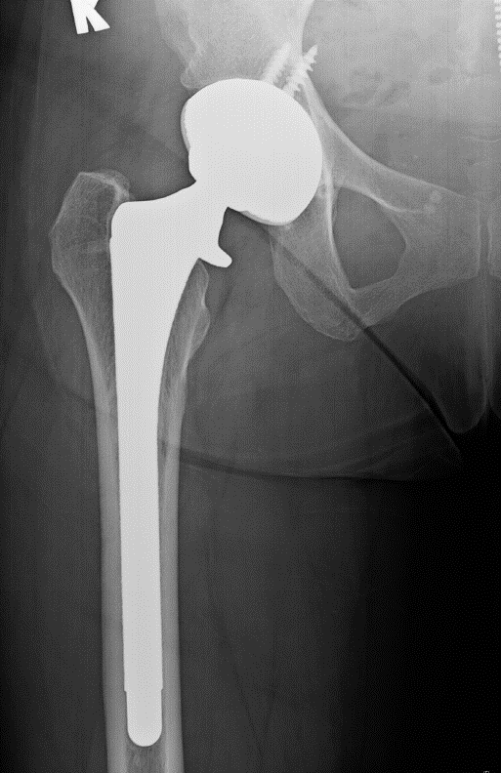
Radiographs
Pre-Revision
Post-Revision

Slide 24
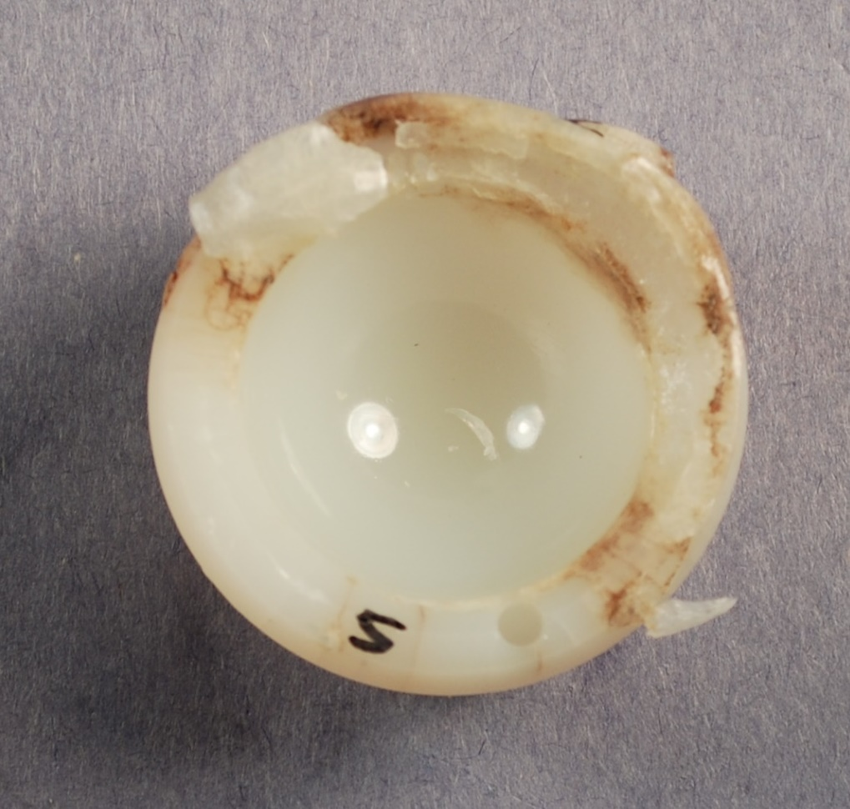
Case Study 4
Female, 54y
Implanted in 2002
Revised in 2013
Revision Reasons: Osteolysis
  Proximal Femur
In vivo 11.25 y
Notes:
RI-H1126

Slide 25
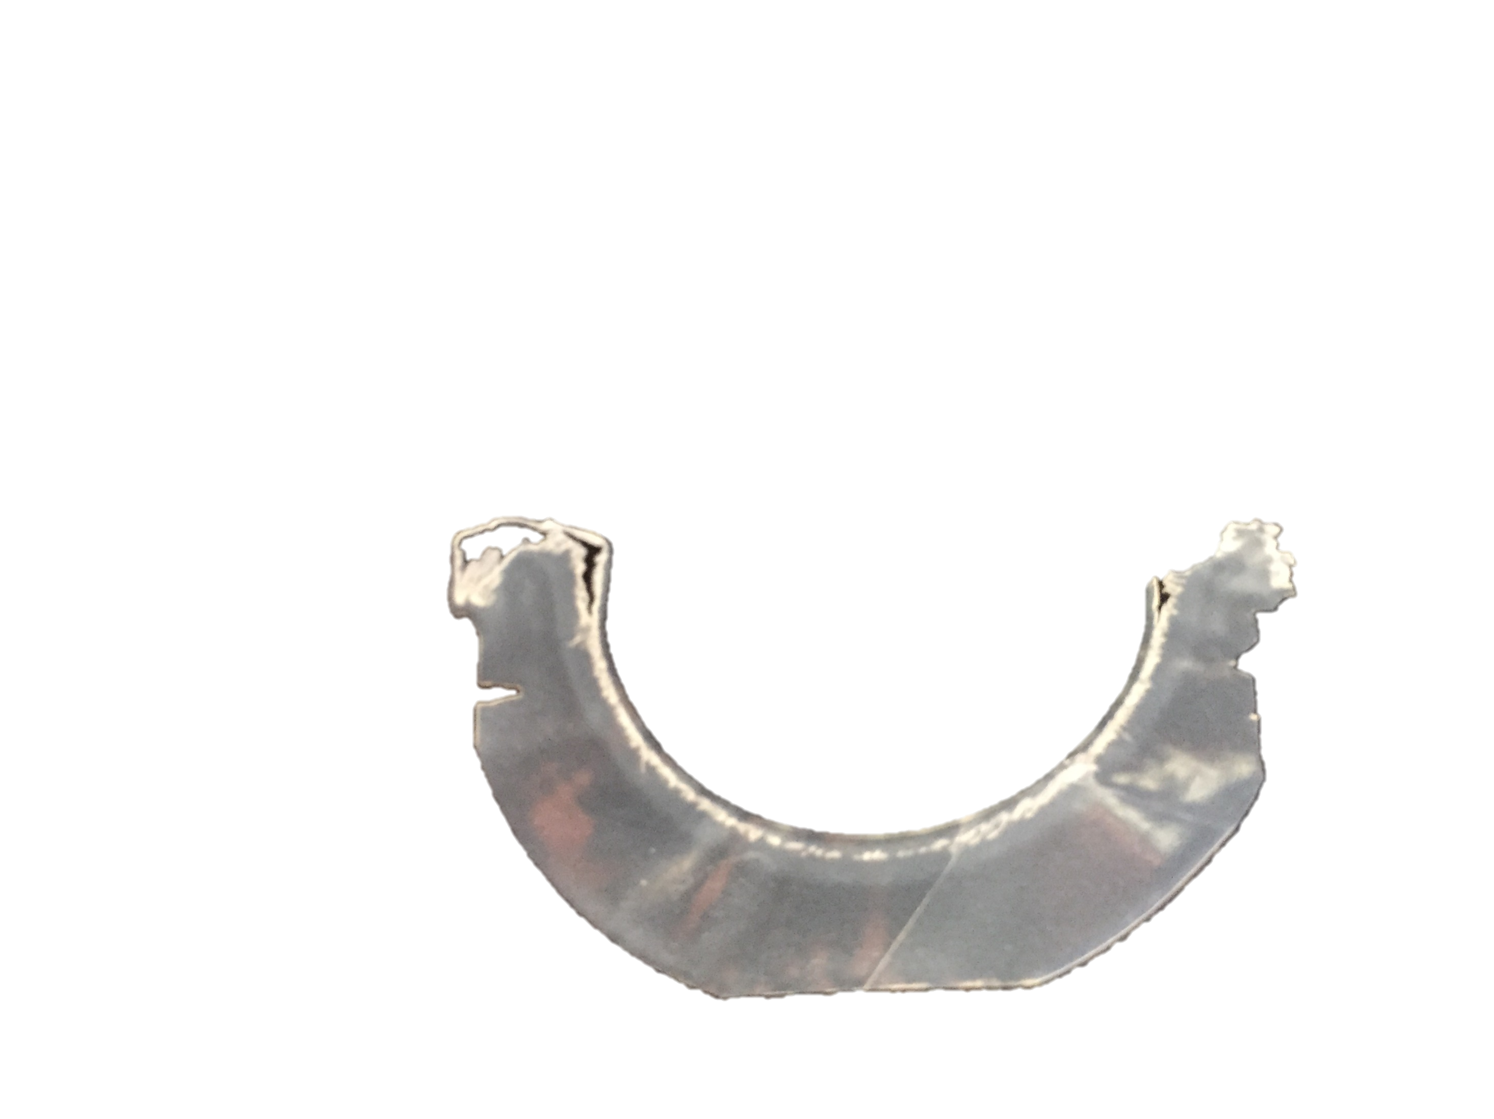
Superior Rim
OI_{Max}: 2.39
OI_{Max}: 5.90
OI_{Max}: 1.54
OI_{Max}: 0.35
OI_{Max}: 8.15
OI_{Max}: 7.61
OI_{Max}: 0.23
OI_{Max}: 0.66
Inferior Backside

Slide 26
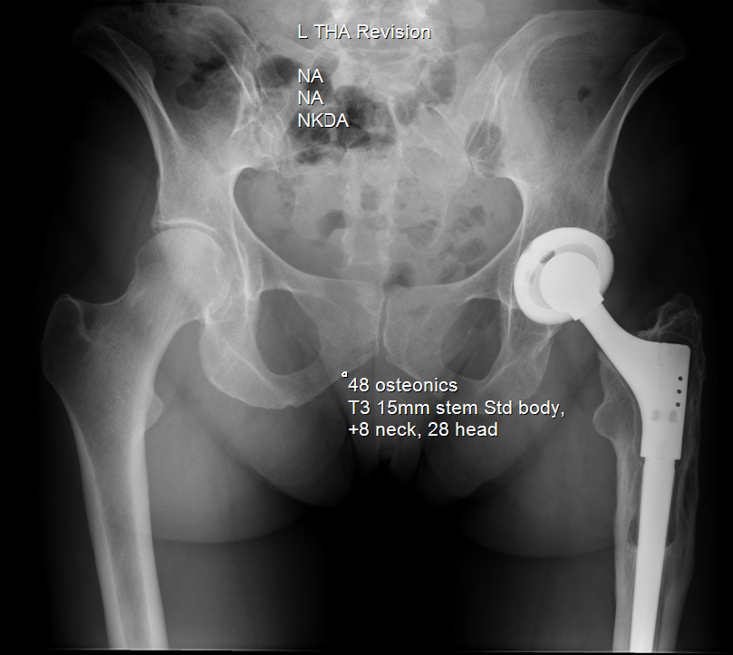
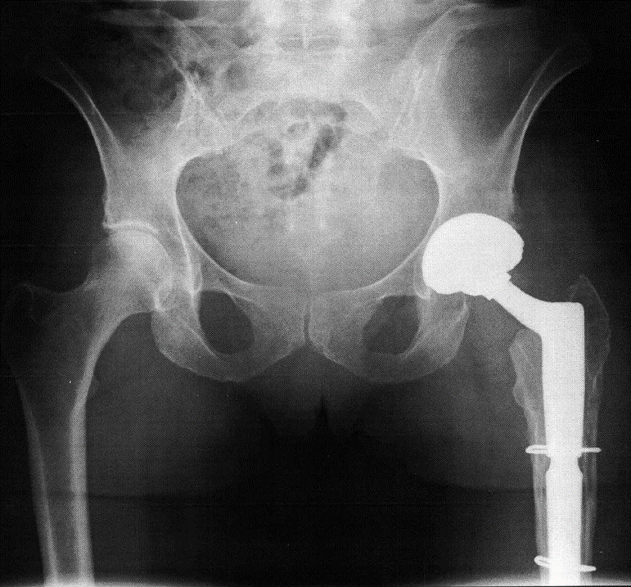
Radiographs
Pre-Revision
Post-Revision

Slide 27
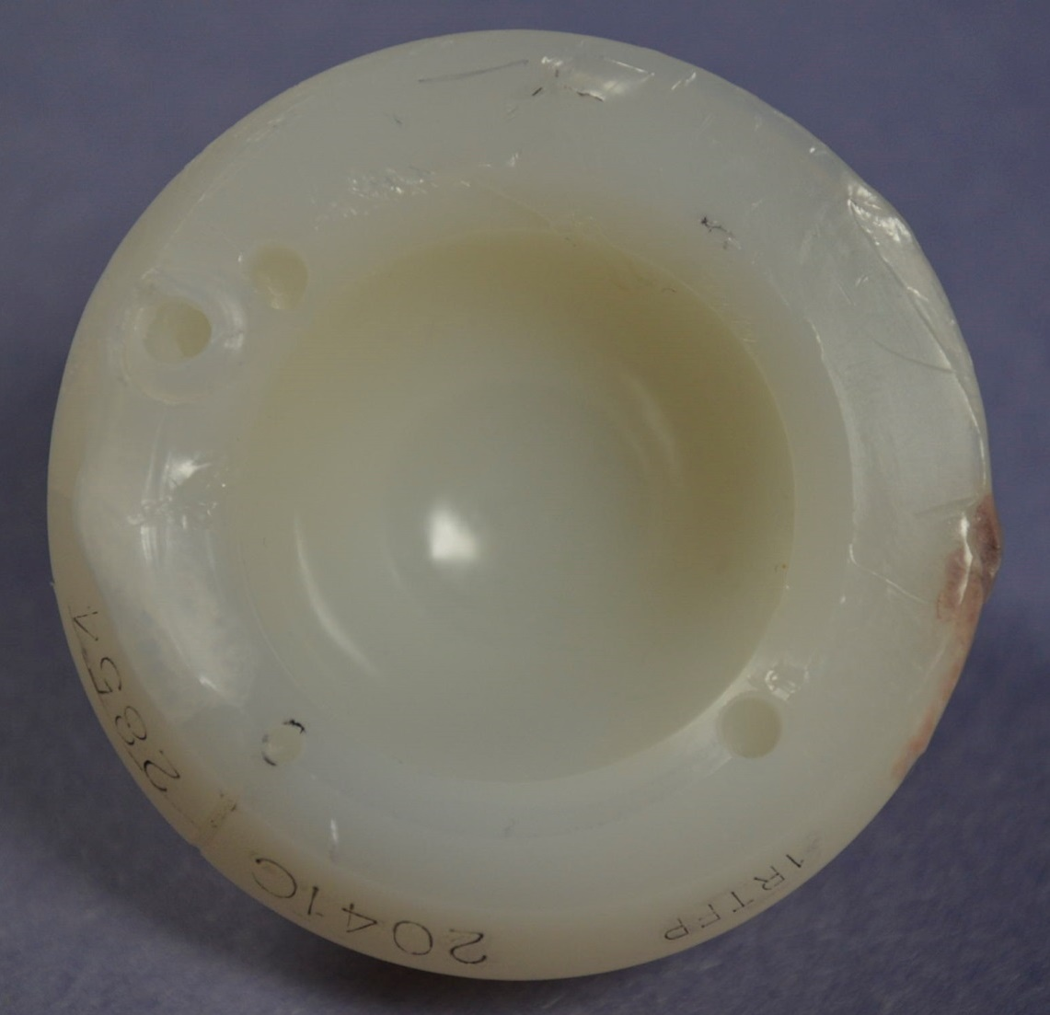
Longest Term Annealed
Female, 61y
  BMI: 34.9 kg/m2
Implanted in 1999
Revised in 2016
  Max UCLA Score: 8
  Revision Reason: recurrent dislocation
Osteolysis
In vivo 17 y

Slide 28

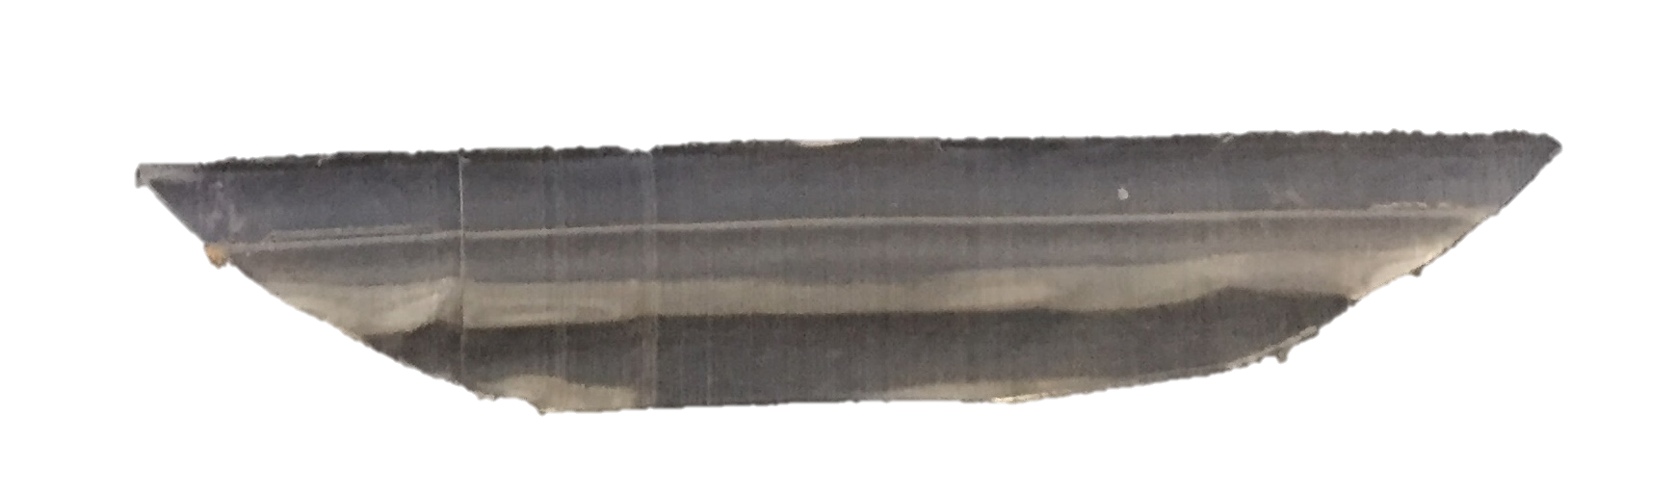
Superior Rim
OI_{Max}: 8.12
OI_{Max}: 5.99
OI_{Max}: 0.30
OI_{Max}: 1.64
OI_{Max}: 0.49
OI_{Max}: 0.48
OI_{Max}: 0.59
OI_{Max}: 0.47
Inferior Backside

Slide 29
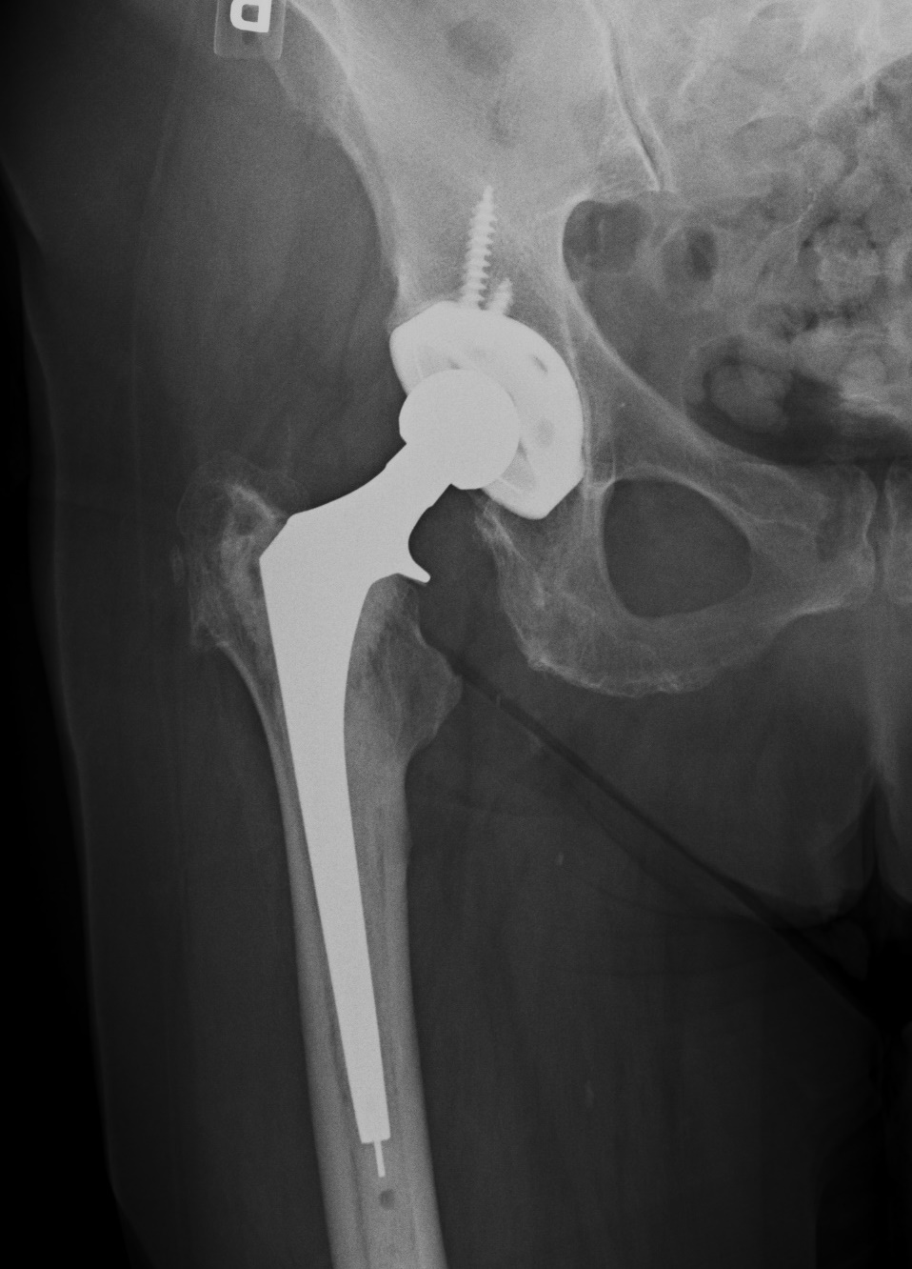
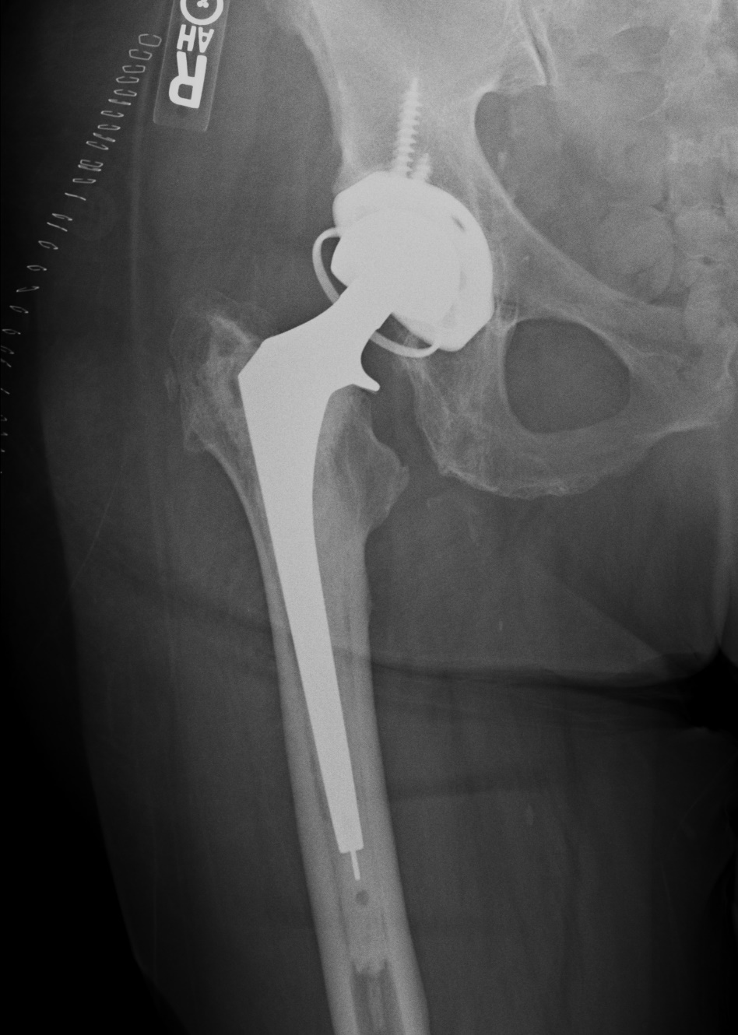
Radiographs
Pre-Revision
Post-Revision
Notes:
Given a constrained liner

Slide 30
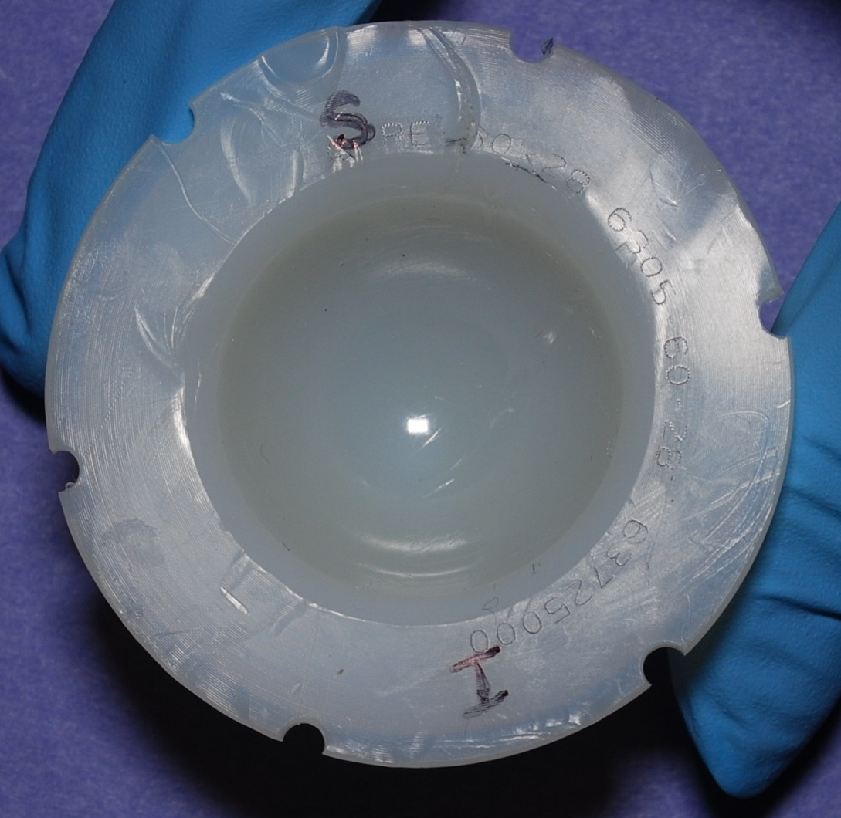
Longest Term Remelted
Male, 60y
  BMI: 25.2 kg/m2
Implanted in 1999
Revised in 2014
  Revision Reason: Recurrent dislocation
In vivo 14.25 y
Notes:
Get revision reason confirmation – send to klein

Slide 31
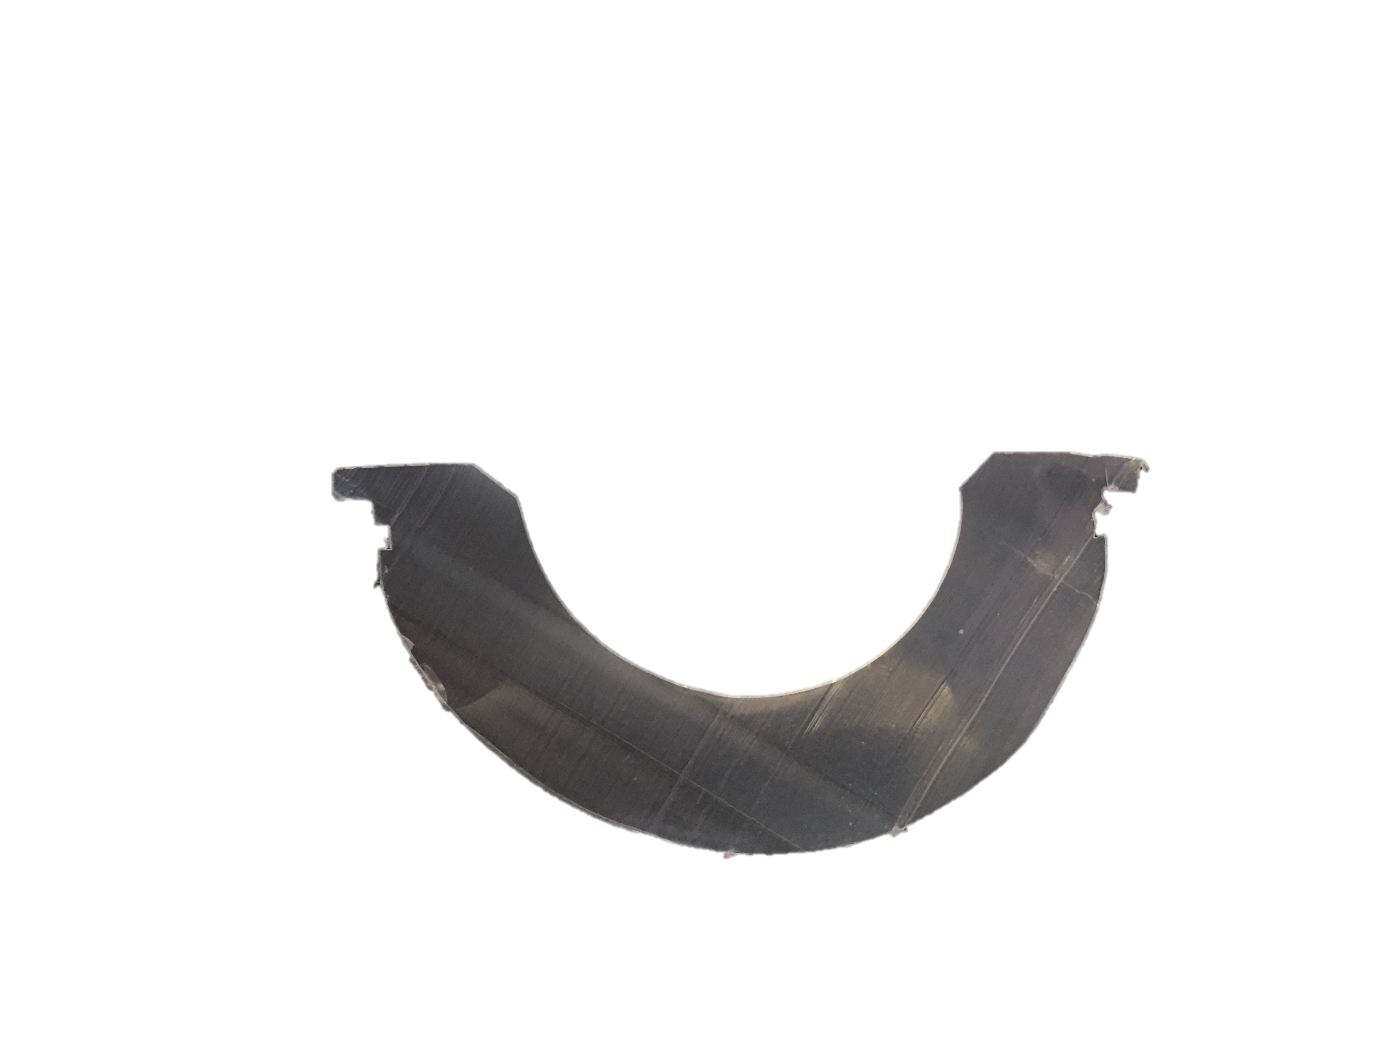
Superior Rim
OI_{Max}: 0.04
OI_{Max}: 0.07
OI_{Max}: 0.04
OI_{Max}: 0.06
OI_{Max}: 0.08
OI_{Max}: 0.19
OI_{Max}: 0.07
OI_{Max}: 0.07
Inferior Backside

Slide 32
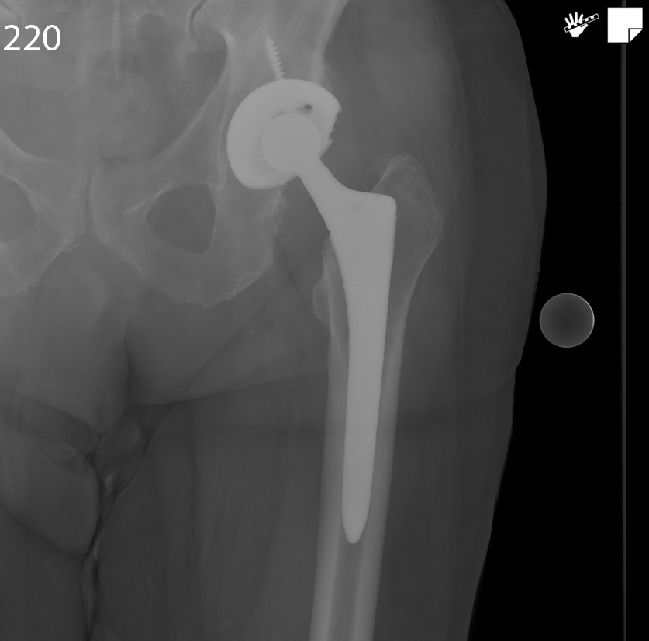
Radiographs
Pre-Revision

Slide 33
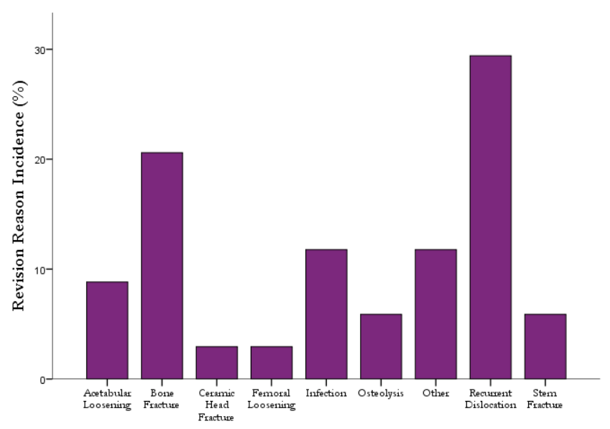
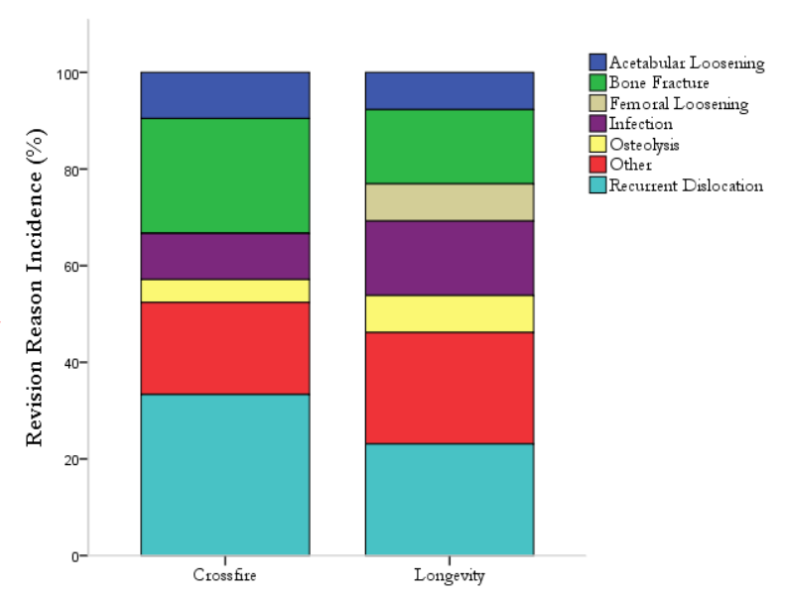
Reasons for Revision (>10y)
Notes:
3 annealed, 5 remelted lysis
18% 38%
Other: migration, trunnion corrosion, pain, implant fracture
Acetabular loosening: JH-H0068, RI-H1009 [no osteolysis], UTHSA-H0022 [osteolysis]
Femoral loosening: 1 case
Implant Fracture: stem, ceramic head

Slide 34
Limitations
Differences between cohorts
  Size
  Implantation time
Cohort restricted to failed retrievals
Third party damage

Slide 35
Conclusion
HXLPE has decrease wear rate compared to CPE
Remelted HXLPE achieves a lower OI
No difference in osteolysis outcomes between annealed and remelted
Future work is required to follow up on observed trends with increased implantation time and sample size

Slide 36
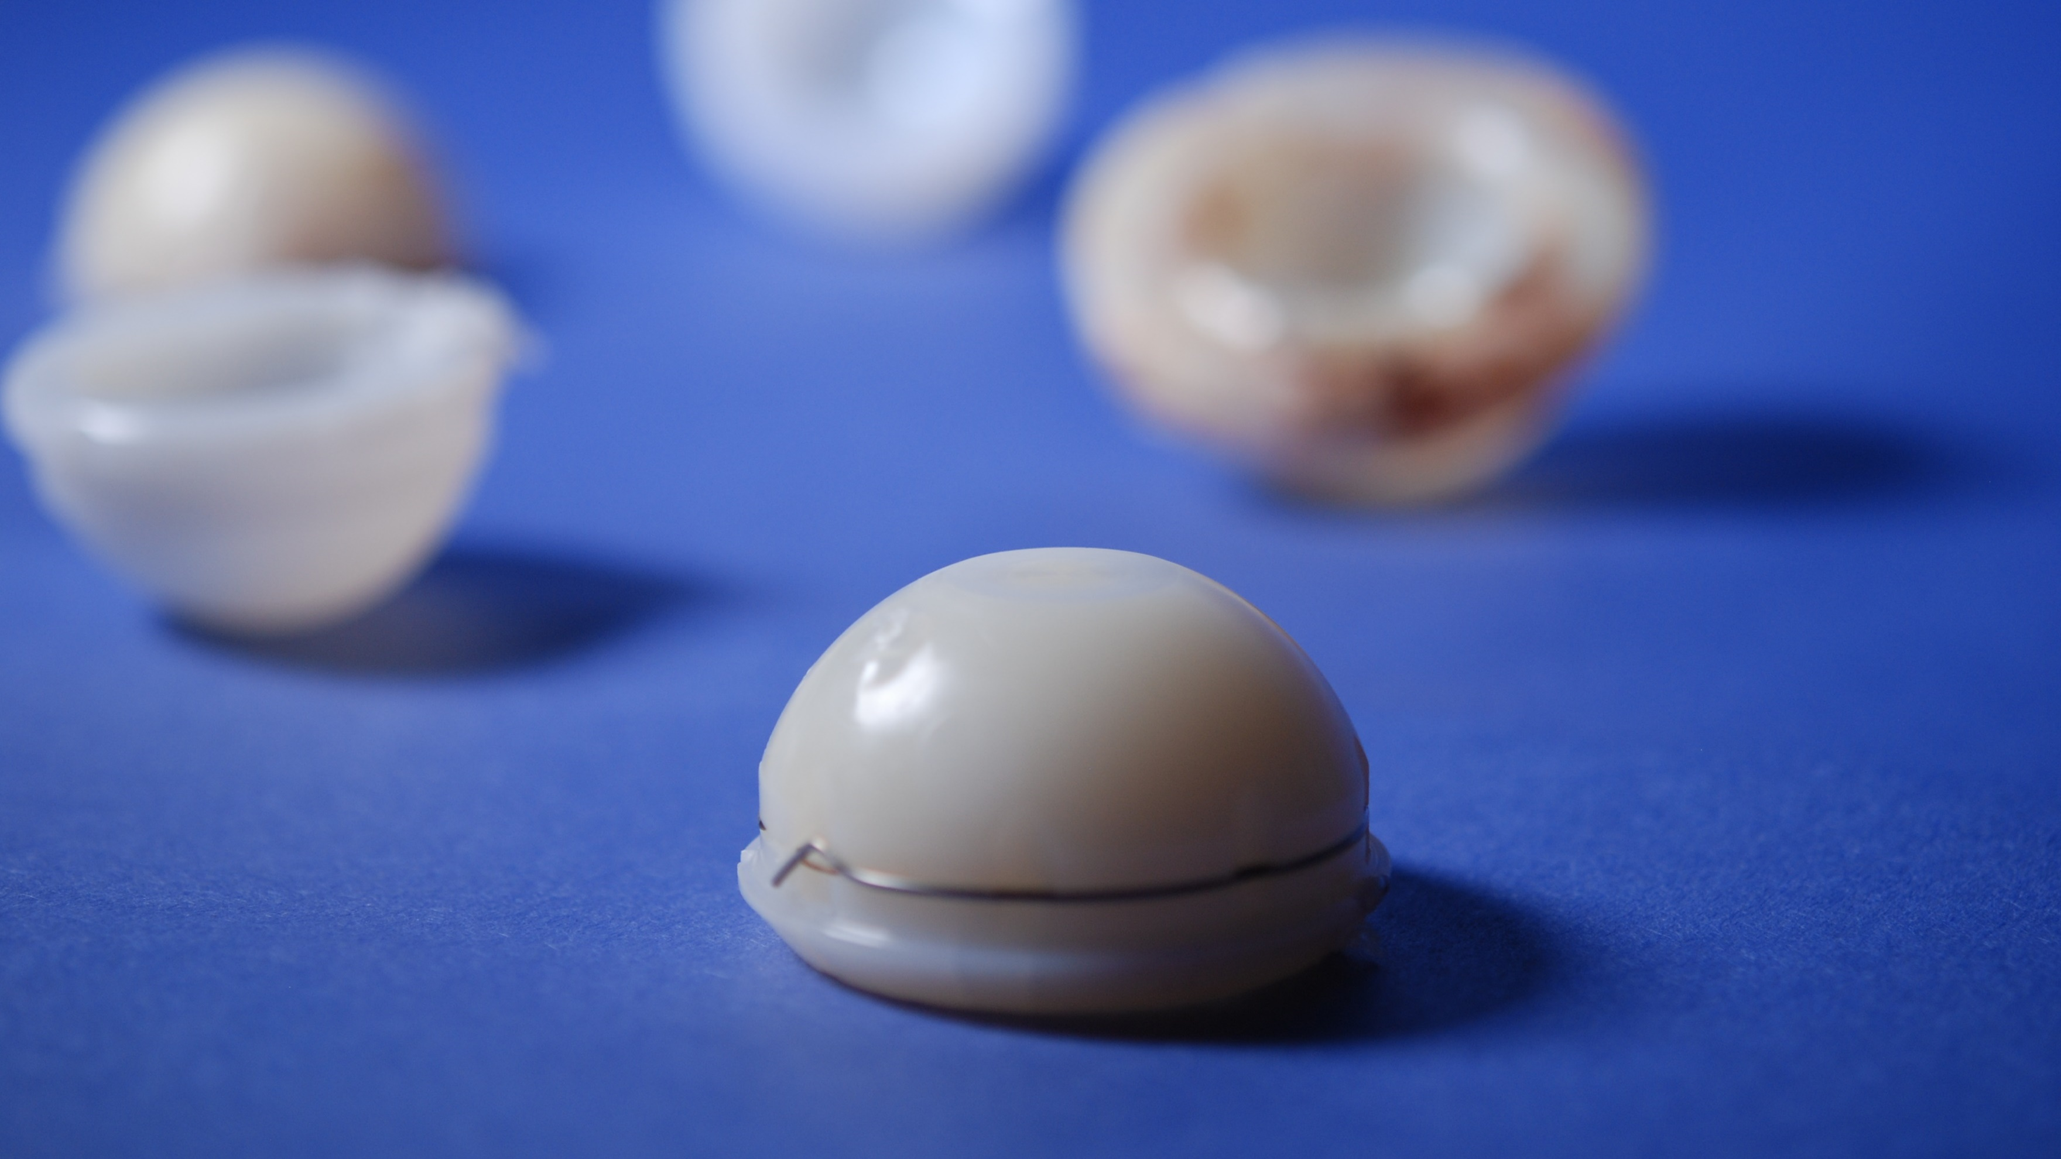
Questions?
Notes:
Look at had 3 cases that have osteolysis
Loosening for acetabular
Look at lysis over all

