Slide 1
Delamination resistance of vitamin E blended and highly cross-linked ultra-high molecular weight polyethylene evaluated by novel accelerated test method
○ Hideyuki SAKODA, Yoshihiro Okamoto and Yuji Haishima
Division of Medical Devices, National Institute of Health Sciences
Yuta Osaka and Keita Uetsuki
Teijin Nakashima Medical Co. Ltd.
Notes:
Thank you Chairman,
And I’d like to thank Organizers for giving me this opportunity.

Slide 2
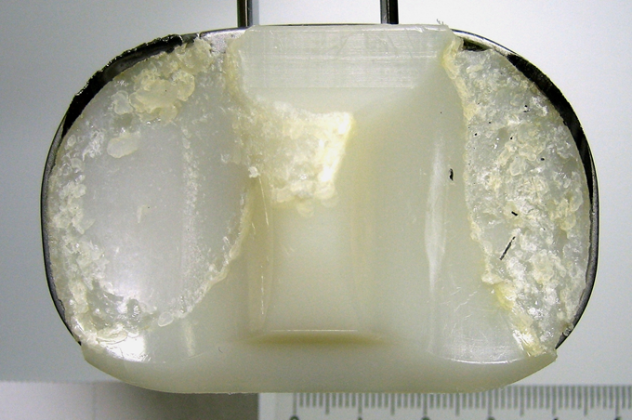
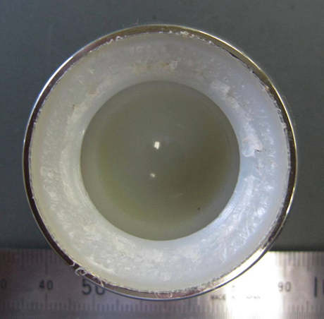
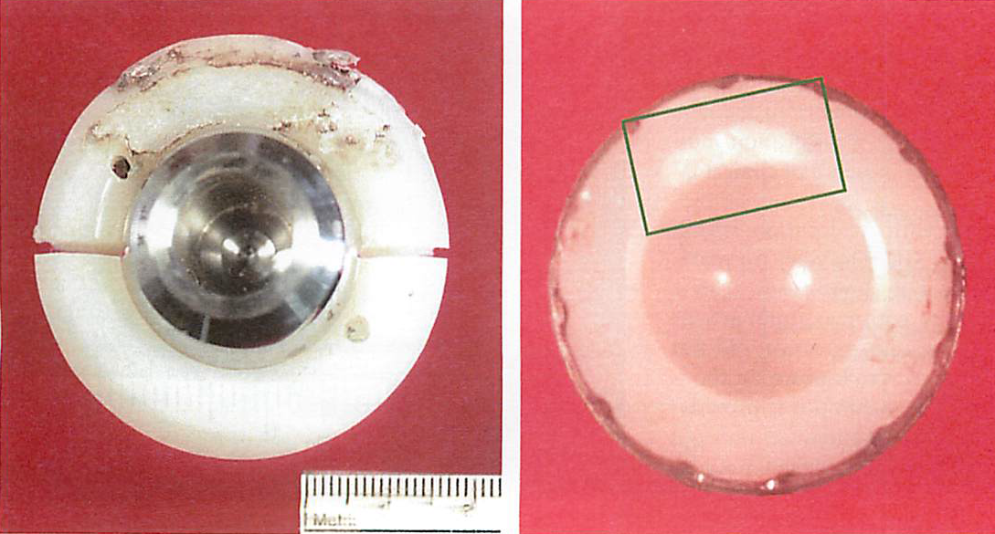
Delamination
Type of fatigue failure
Initiates from internal defects beneath the surface
Generates millimeter-sized flakes
Common destruction mode of ultra-high molecular weight polyethylene (UHMWPE) used at articulating surface of artificial joints
Found at
  knee joints
  (Medel JBJS-Am 2009, Greulich J arthop 2012, etc)
  rim of acetabular components of hip joints
  (Currier JBJS-Am 2007, Sakoda JJCB 2008)
  shoulder joints
  (Gunther J Arthop 2002)
Complex mechanism – induced by stresses beneath the surface generated by compressive load at low conformity contact (Bartel CORR 1995)
Currier JBJS-Am 2007
Notes:
Delamination is a type of fatigue failure, which initiates from internal defects beneath the surface, and results in generation of millimeter-sized flakes.
It is one of common destruction modes of PE component used at the articulating surface of artificial joints.
Delamination are found at the articulating surface of knee joints, rim of acetabular components of hip joints, and the articulating surface of shoulder joints.
It has complex mechanism, but the most important factor is low conformity contact, because compressive load at low conformity contact generates the maximum von Mises’ stress beneath the surface.

Slide 3
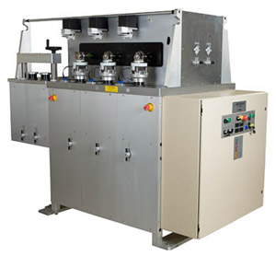
Previous in vitro tests – Joint simulator
Advantages
Final products are evaluated
  Design factors
  Material factors
Most clinically relevant loading and motion
Disadvantages
Limited acceleration
Very complex
Not easy to evaluate the effect of component design
  Component design itself affects joint loading and motion in vivo
* Conforming inserts are more closely associated with delamination than less-conforming inserts in a retrieval study, probably due to the higher in vivo constraint-induced stresses. (Wimmer CORR 2012)
www.amti.biz
Notes:
Joint simulator wear test is one way to evaluate delamination resistance.
It uses final products, so both design factors and material factors can be evaluated.
And it uses the most clinically relevant loading and motion.
However, there are also some disadvantages.
The tests cannot be accelerated much, if in vivo loading condition is used.
And it is a very complex test.
And actually, component design affects in vivo joint loading and motion. So the effect of the difference in design cannot be evaluated under the same input.

Slide 4
Previous in vitro tests – Ball-on-flat
Distinctive feature
Pin-on-plate wear test using simple reciprocation
Simple
  Material test
  Design factors eliminated
Many experiences (Bell JOA 1998, Reeves IMechE 2000, Popoola JOR 2010, Wannomae JOA 2010, Saikko Tribol Int 2014)
Standardized (ASTM F 732-00(2011))
Limitation
Delamination is reproduced only in ‘obviously’ deteriorated UHMWPE
  Aged historical UHMWPE (gamma air)
  Aged conventional UHMWPE (gamma inert)
Risk of delamination can not be evaluated
Notes:
Another way to evaluate delamination is pin-on-plate wear test using simple reciprocation.
It is a simple material test, and design factors are eliminated.
There are many experiences, and there is also a standard.
However, delamination has been reproduced only in ‘obviously’ deteriorated PE, such as aged historical PE and aged conventional PE.
So, it is not possible to evaluate the risk of delamination.

Slide 5
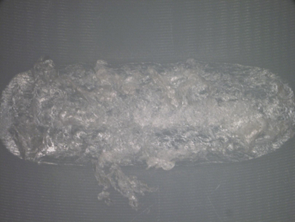
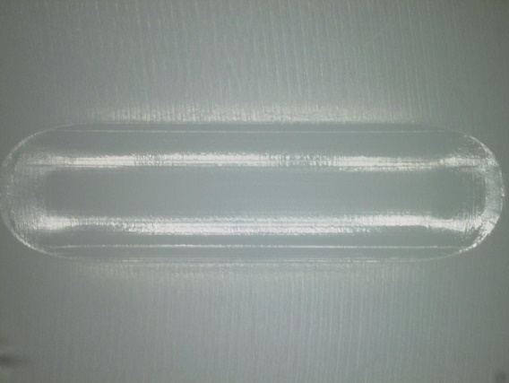
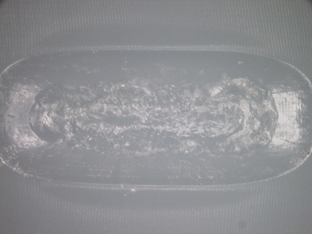
U-shaped motion
First reported in 1999 by Tomita et al. (Tomita JBMR-B 1999)
Creates more internal cracks than simple reciprocation
(measured by scanning acoustic tomography, in water lubricant)
10 mm
Modification (Sakoda JJCB 2012)
  Serum based lubricant
  Extended test duration (until delamination or 1 million cycles)
Dramatic acceleration of delamination process
Delamination in virgin UHMWPE
1 mm
U-shaped motion
Gamma air, AA
Virgin UHMWPE
Virgin UHMWPE
U-shaped motion
at 100 cycles
Simple reciprocation
at 1,000,000 cycles
U-shaped motion
at 160,000 cycles
Notes:
So, I’d like to introduce the U-shape motion.
The U-shape motion was first employed by Prof. Tomita in 1999.
They used scanning acoustic tomography to measure the area of internal cracks and found that the U-shaped motion creates more internal cracks than the simple reciprocation.
In our previous study, we modified the test method to use serum based lubricant instead of distilled water, so that we can extend the test duration.
As a result, we found great acceleration in the reproduction of delamination, for example, as shown here, delamination was reproduced in oxidized PE within 100 cycles.
And we succeeded to reproduce delamination in virgin PE as shown here, while with simple reciprocation, the surface is very smooth even after 1 million cycles.

Slide 6
Objectives
To verify the delamination test using U-shaped motion
  By making direct comparison of delamination resistance of various UHMWPEs using the tests
To investigate the relation between the results of delamination tests and those of fatigue crack growth tests
To assess the risk of delamination of components made of contemporary UHMWPEs
Notes:
So, the objectives of this study are,
To verify the delamination test with the U-shaped motion by making direct comparison of delamination resistance of various PEs using the tests.
And to investigate the relation between the results of delamination tests and those of fatigue crack growth tests, which is one of the most common method to evaluate fatigue property of PE.
And finally, to assess the risk of delamination of components made of contemporary PEs.

Slide 7
Materials
Name | Description
Virgin | UHMWPE as received (GUR 1020)
G25 | Conventional, irradiated at 25 kGy in inert
G25air | Historical, irradiated at 25 kGy in air
G100-R2 | Irradiated at 100 kGy in inert, remelted at 160 °C for 2 h
G100-Ax | Irradiated at 100 kGy in inert, annealed at 110 °C, x: annealing time in hours
VEPE | 0.3% vitamin E blended UHMWPE (GUR1050)
VE-Ex | Vitamin E blended HXLPE, x: e-beam irradiation dose in kGy annealed at 110 °C for 72 h in vacuum
Accelerated aging (AA)
80°C in air for 21 days
Compulsory aging (CA)
Gamma irradiation at 25 kGy in air and AA
Used for vitamin E blended materials
Notes:
We used several materials.
One is virgin PE as received.
Conventional PE, which was irradiated in inert.
Historical PE, which was irradiated in air.
Remelted highly crosslinked PE.
Annealed highly crosslinked PE with various annealing time.
Vitamin E blended PE.
And vitamin E blended and e-beam irradiated highly crosslinked PE with various irradiation dose.
Accelerated aging was conducted at 80 degrees in air for 21 days.
For vitamin E blended materials, to test under severer condition, compulsory aging was used, which consists of gamma irradiation in air and accelerated aging.

Slide 8
Methods – FTIR
Fourier transform infrared microscopy (FTIR)
100–200 µm thick specimens
Measurement through thickness
Oxidation index
A₁₇₂₀ / A₁₃₇₀ (ASTM F2102-01)
  Maximum value (OI_{MAX}) was used for further analysis
Crystallinity index
(A₁₈₉₆ / A₁₃₀₅) / (A₁₈₉₆ / A₁₃₀₅ + 0.25) x 100 (Costa Poym Test 2001)
  Average value (CI) was used for further analysis
Notes:
FTIR analysis was conducted to obtain maximum oxidation index (OImax) and average crystallinity index (CI).

Slide 9
Methods – Delamination test
Two dimensional pin-on-plate wear test machine was used
Vertical load
(196 N)
Co-Cr alloy pin
(SR = 3 mm)
(Ra < 0.02)
Bovine serum lubricant
20g/L protein
EDTA, NaN₂
Plate specimen
(40 x 40 x 10 mm)
Sliding motion
(10 x 1 mm)
(Top view)
Notes:
For the delamination test, two-dimensional pin-on-plate wear test machine was used.
PE specimen with the thickness of 10 mm was fixed in a bath filled with a bovine serum based lubricant.
Compressive load of 20 kg was applied through cobalt-chrome alloy pin with radius of 3 mm.
Then the U-shape motion with 10 mm and 1 mm was applied.

Slide 10
Methods – Delamination score
Periodical stops to visually inspect for occurrence of delamination
Test duration: Up to 1 million cycles
Delamination score based on cycles to delamination
  Cycles to delamination is exponential
  Need to differentiate ‘delamination at 1 million cycles’ and ‘no delamination at 1 million cycles’
Delamination score
Cycles
No
delamination
5
1,000,000
4
300,000
3
100,000
2
10,000
1
1,000
0
Notes:
The tests were periodically stopped and visually inspected for occurrence of delamination.
The tests lasted until delamination or 1 million cycles.
We first thought to use cycles to delamination for further analysis.
But we needed to differentiate ‘delamination at 1 million cycles’ from ‘no delamination at 1 million cycles,’ we decided to use the delamination score as shown here.

Slide 11
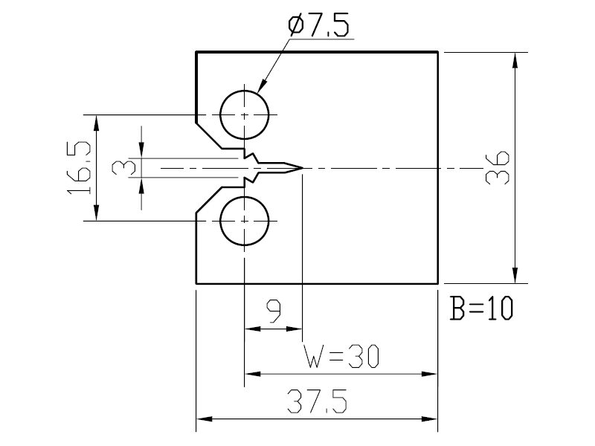
Methods – Fatigue crack growth test
Based on ASTM E647
W = 30, B = 10, 1 Hz
Stress intensity factor range threshold ΔK_{th} was used for further analysis
ΔK_{th}
C(ΔK)^{m}
da/dN
ΔK
Dimensions of the compact tension specimens used for fatigue crack growth tests
Schema of tensional loading and fatigue crack growth
Schema of Paris’ low and parameters obtained from fatigue crack growth tests
Notes:
We also conducted fatigue crack growth test because it is one of the most common test method used to evaluate the fatigue property of PE.
We used the specimens as shown here, and tested at 1 Hz.
Stress intensity factor range threshold ΔK_{th} was used for further analysis.

Slide 12
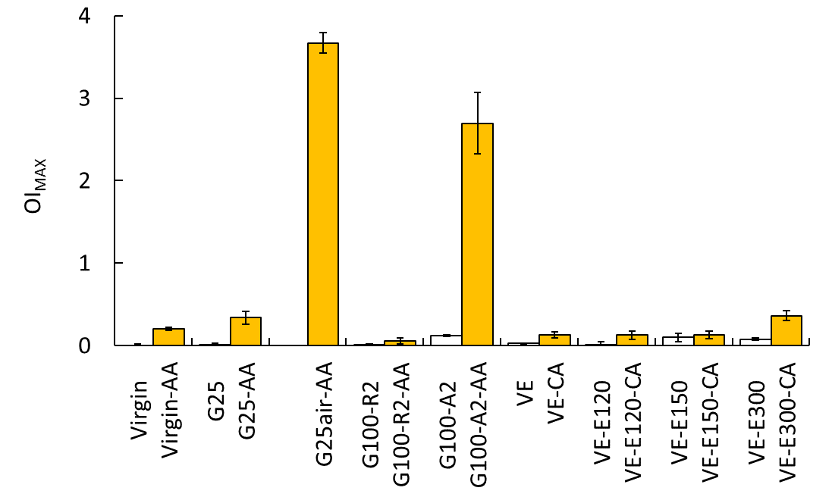
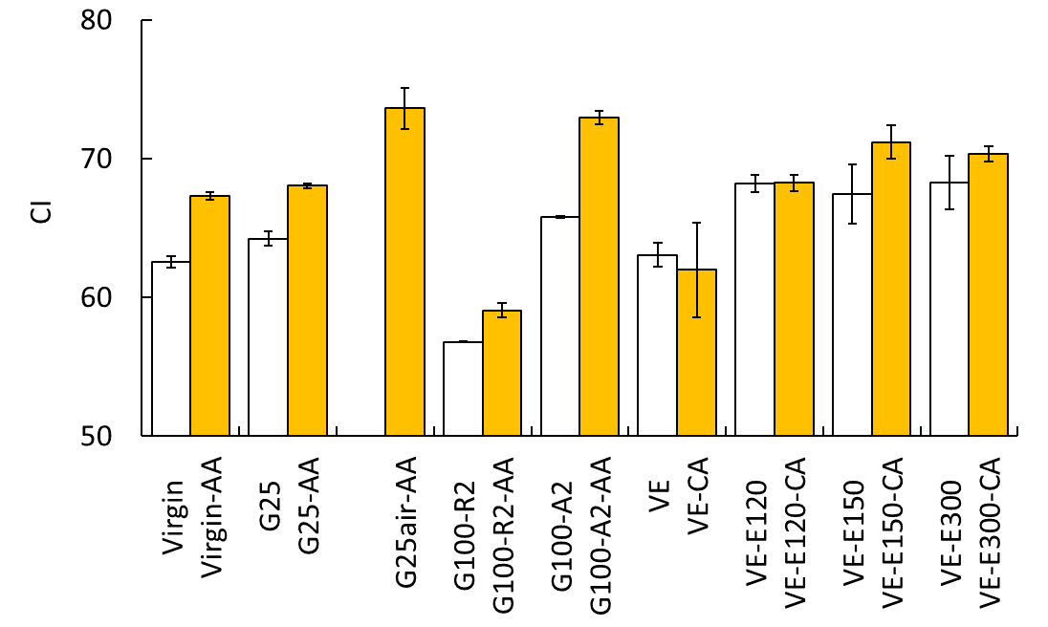
Results – Oxidative stability
G25air-AA (aged historical UHMWPE) had the highest OI_{MAX} and CI indicating oxidative degradation
There were some materials with inferior oxidative stability indicated by increase in both OI_{MAX} and CI after artificial aging
  G100-A2
  G25
  Virgin
*
□ Without aging
■ After aging
*
*
*
*
*
*
*
*
*
*: Significant difference between non-aged and aged specimens.
Notes:
G25air-AA, mimicking aged historical PE and representative material for oxidative degradation had the highest OImax and CI.
Highly crosslinked PE annealed for 2 hours, gamma inert PE and virgin PE were indicated to have inferior oxidative stability because increases in both OImax and CI were observed.

Slide 13
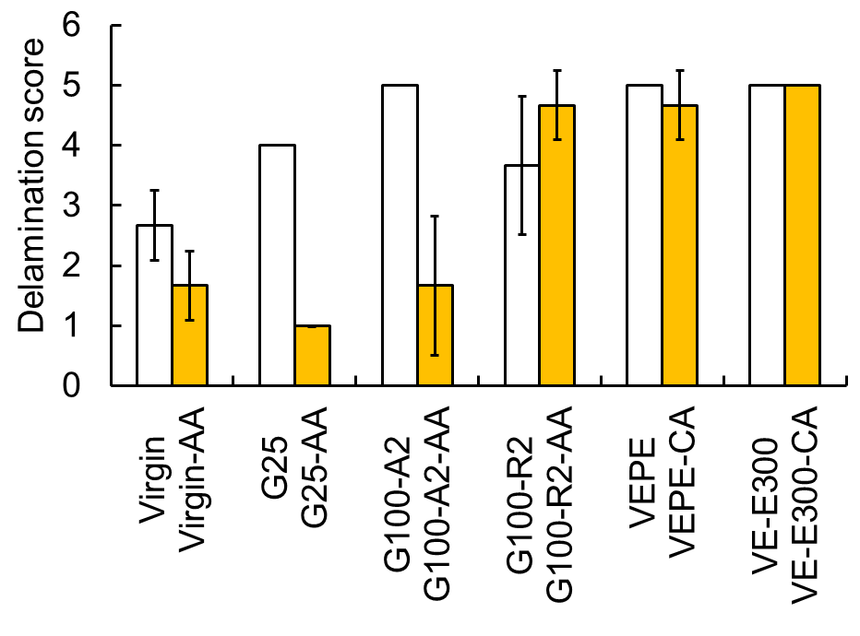
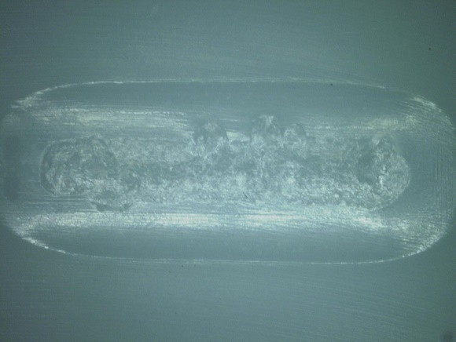
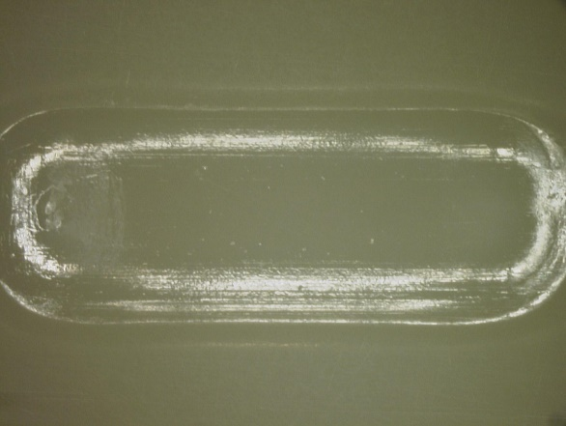
Results – Delamination score
□ Without aging
■ After aging
#
*
#
#
#
#
#
*
#
G100-A2-AA
at 10,000 cycles
*: Significant difference between non-aged and aged specimens.
#: Significant difference against the virgin UHMWPE.
VE-E300-CA
at 2,040,000 cycles
(Additional cycles tested)
Notes:
Materials with inferior oxidative stability, such as highly crosslinked PE annealed for 2 hours and gamma inert PE, had low delamination score after accelerated aging.
Irradiated materials had higher delamination score than virgin if there is no oxidation.
Vitamin E blended materials had excellent delamination score irrespective of crosslinking or compulsory aging.
One sample of vitamin E blended and highly crosslinked PE, we tested for 2 million cycles, but there was no delamination.

Slide 14
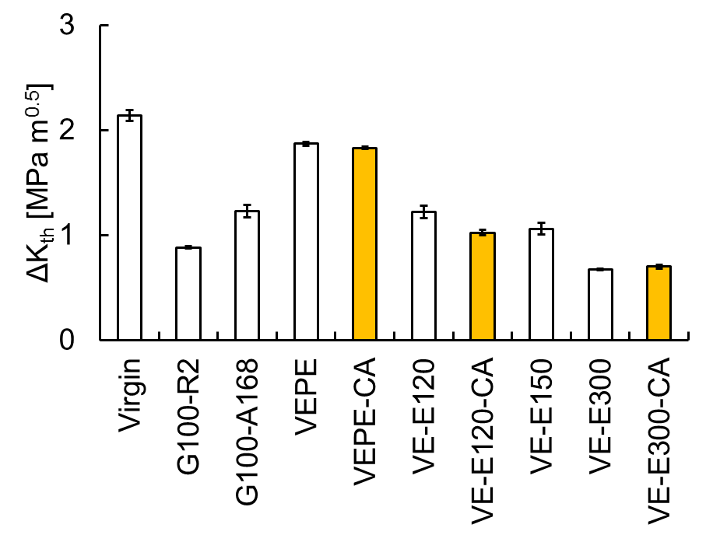
Results – Stress intensity factor threshold
□ Without aging
■ After aging
ns
ns
ns: No significant difference between non-aged and aged specimens.
Notes:
Highly crosslinked PEs, especially remelted material, had lower delta K th, which was consistent to previous reports.
Vitamin E blended highly crosslinked PE also tended to have low delta K th.
These results were NOT consistent to the results of delamination tests.

Slide 15
Discussion – in vivo vs in vitro
Results of delamination test agrees with results of retrieval studies (and other in vitro delamination studies)
in vitro
(Delamination test)
in vivo
(Retrieval studies)
VE-E300, VEPE, G100-A
G100-R, G25
Virgin
G100-A2-AA
G25-AA
G25air-AA*
No delamination on ethylene oxide gas sterilized UHMWPE
(Greulich JOA 2012, MacDonald CORR 2012)
Rim delamination on annealed HXLPE
(Currier JBJS-Am 2007)
Delamination reported by retrieval studies (and other in vitro studies)
*: Results for delamination test of G25air-AA are previously reported that delamination was reproduced on all three specimens within 100 cycles, corresponding to delamination score of 0 (Sakoda JJCB 2012)
Notes:
Vitamin E blended PE and vitamin E blended highly crosslinked PE had the highest delamination score.
Irradiated PE also had delamination score higher than virgin if there is no oxidation.
Highly crosslinked PE that has been annealed for 2 hours, conventional PE, and historical PE had delamination scores lower than virgin, after accelerated aging.
These results were consistent to the results of retrieval studies.
Because no delamination was reported on EOG sterilized PE by retrieval studies, materials with delamination score of equivalent to or higher than virgin are considered to have little risk of delamination.

Slide 16
Discussion – Fatigue crack growth
Results of delamination test was NOT consistent to results of fatigue crack tests
  Fatigue crack growth tests only evaluate the final step of the complex mechanism of delamination
Delamination test
Fatigue crack propagation test
Initial internal defects
formed at consolidation
Additional defect formation by loading
Crack growth
Delamination
Notes:
Results of delamination test was NOT consistent to those of fatigue crack growth tests,
Because delamination has complex mechanism such as internal defect formation and crack growth,
And fatigue crack growth tests only evaluate the final step,
So there is discrepancy between the two tests.

Slide 17
Discussion – Why U-shape motion?
With simple reciprocation, conformity improves due to plastic deformation
U-shape motion prevents full contact
At Start
Simple reciprocation
Conformity improves to reach full contact
U-shape motion
Two tracks formed and prevents full contact
Notes:
So, why U-shape motion accelerates delamination.
At the start, the contact stress is higher than the hardness of PE due to low conformity.
Therefore, PE starts to deform plastically.
With simple reciprocation, the conformity improves until the contact stress equals the hardness of PE.
And eventually reaches full contact.
With such contact, the highest von Mises’ stress is on the surface, NOT beneath the surface, so delamination does not occur.
With the U-shape motion, because two tracks are formed, it is hard to reach full contact.
So, delamination occurs.

Slide 18
Conclusion
Accelerated delamination test using U-shape motion was developed
  Material test (design factor eliminated)
  Comparative test (needs control)
  Accelerated test (not quantitively mimic in vivo condition)
Consistent to retrieval studies (and other in vitro studies)
Results were NOT consistent to those of fatigue crack growth test
  Delamination has complex mechanism
  Fatigue crack growth test evaluates only final step of delamination
Delamination test can not be substituted by fatigue crack growth test
Notes:
In conclusion,
Accelerated delamination test using U-shape motion was developed.
This test is a material test, so design factor is eliminated.
This test is a comparative test, so a control material is required, and presumably virgin PE is a good candidate.
And to accelerate the test, this test does not quantitively mimic in vivo condition.
This test was validated because the results of the tests were consistent to retrieval studies and other in vitro studies.
The results of the delamination test were NOT consistent to the results of fatigue crack growth test.
Because, delamination has a complex mechanism and fatigue crack growth test evaluates only the final stage of delamination.
Therefore, delamination test can not be substituted by fatigue crack growth test, and it is recommended to perform delamination test separately.

Slide 19
Conclusion and significance
Contemporary UHMWPEs have little risk of delamination (Unless there is no oxidation)
  Crosslinking improves delamination resistance
  Vitamin E blending improves delamination resistance
  Note: the test does not quantitatively predict durability in vivo
How utilize the delamination test
  To avoid inappropriate material to be used at articulating surface with low conformity in the future
  Many new materials are under development
    Carbon-PEEK (Brockett Wear 2017)
    CNT-UHMWPE
    Cellulose nanofibers
Notes:
Contemporary PEs, such as highly crosslinked PE and vitamin E blended PE, was found to have little or no risk of delamination, unless there is no oxidation.
And the results indicated that crosslinking and vitamin E blending improve delamination resistance.
However, it should be noted that the test does not quantitatively predict durability in vivo as it is accelerated and comparative test.
So, what is the significance of this test, if materials used these days have little risk of delamination.
It should be used to avoid inappropriate materials to be used at articulating surface with low conformity in the future.
Many new materials are under development.
And I think delamination resistance should be added to the check list in addition to wear resistance, fatigue resistance and so on.

Slide 20
Thank you for your attention
Notes:
Thank you for your kind attention.

